Slide 1
LIFE ip azores natura (life17IPE/PT/00010) Active protection and integrated management of Natura 2000 Network in Azores PROJECT DATA
EXECUTION: 1/01/2019 – 31/12/2027 (9 YEARS)
Coordination: Direção Regional do Ambiente (terrestrial environ
Partners:
Direção regional dos assuntos do mar (marine environment)
AZOrina sa (comunication and environmental education)
spea (birds)
Reserva Mundial de la Biosfera La Palma (pilot on IAS)
Budget: 19,215,897 € *
Life Co-financing: 11,529,537 € (60%)

Slide 2
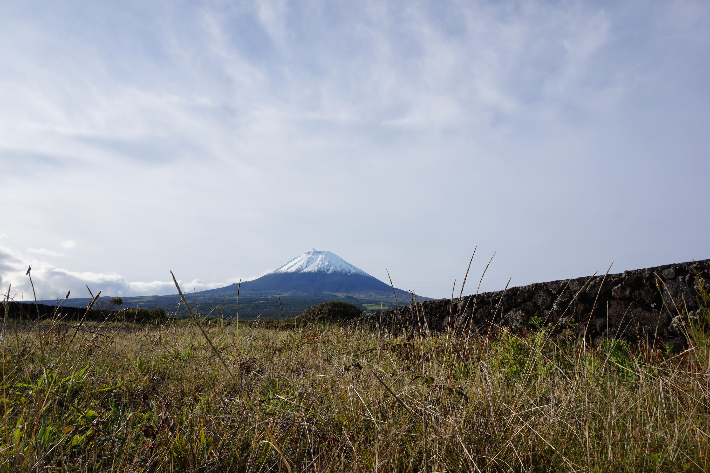
LIFE ip azores natura (life17IPE/PT/00010) Active protection and integrated management of Natura 2000 Network in Azores conservation works

Slide 3
LIFE ip azores natura (life17IPE/PT/00010) Active protection and integrated management of Natura 2000 Network in Azores conservation works
23 SAC’s, 15 SPA’s and 3 SCI’s of the Natura 2000 (N2000) Network in the Azores, seeking to attain a significant contribute for the conservation of species and habitats protected by the Habitats and Birds Directives that underlie their designation.
facilitating the implementation of the regional Prioritized Framework Programme (PAF)
In all, the IP works are expected to secure or bring to a more favourable conservation status:
8 HD protected species currently assessed in Unfavourable / Bad (U2);
10 HD protected species currently assessed in Unfavourable / Inadequate (U1);
3 HD protected habitats currently assessed in Unfavourable / Bad (U2);
6 HD protected habitats currently assessed in Unfavourable / Inadequate (U1);
8 BD protected species (1 terrestrial, 7 seabirds) needing improvement of their habitats to secure results obtained with former conservation.

Slide 4
LIFE ip azores natura (life17IPE/PT/00010) Active protection and integrated management of Natura 2000 Network in Azores conservation works
on-field conservation for improvement of conservation status of 24 species and 13 habitats
habitat improvement for the Azores bullfinch
control/eradication targeting IAS
Fill knowledge gaps on distribution and/or conservation status/threats for specific species/habitats
ex-situ conservation, embracing 80% of the endemic flora of the Azores
Reinforce capability for N2000 surveillance
Develop and deliver, to technical and operational staff, specific training on N2000 values, objectives, threats/problems and concrete conservation needs
Develop and set an operational GIS database for N2000 management
Reinforce integration of N2000 conservation goals in other sectoral policies, by means of pilot and/or demonstration works dealing with tourism (regulation of whale watching), fisheries (use of biodegradable fishing lines; catch of species with commercial interest), agriculture (EARDF advice and cattle management) and marine transport
Raise awareness of local population and relevant stakeholder’s
engage local agents towards further use of rural and fisheries development support schemes by means of th technical advice;
Promote sustainable use of N2000 areas by testing/essay of adequate solutions for pedestrian tourism
Promote better conditions for sustainable use and improvement of profitability of private agents, by directly working with agents operating whale watching, diving, and related marine activities, and fisheries

