Slide 1
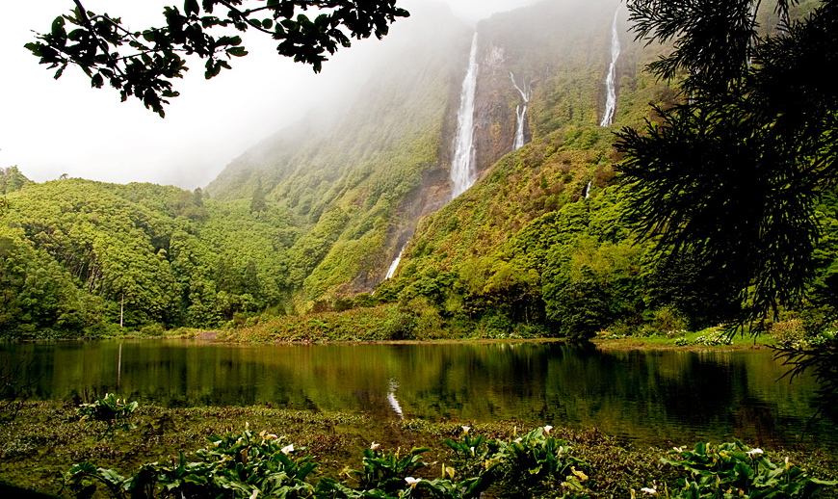
Active protection and integrated management of Natura 2000 Network in Azores LIFE IP AZORES NATURA – LIFE 17 IPE/PT 0010
Universidade dos Açores
http://siaram.azores.gov.pt/
Evento de Encerramento do Projeto de
Capacitação Nacional LIFE14 CAP/PT/000004
Lisbon, December 6th and 7th of 2018

Slide 2
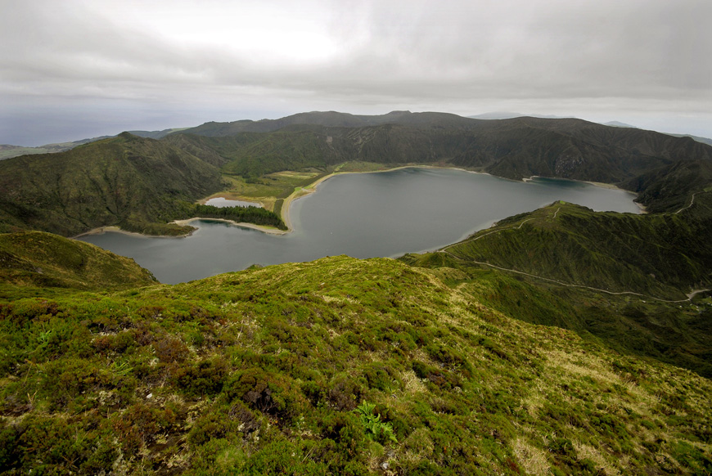
http://siaram.azores.gov.pt/
Duration: 9 years (2019 – 2027)

Slide 3
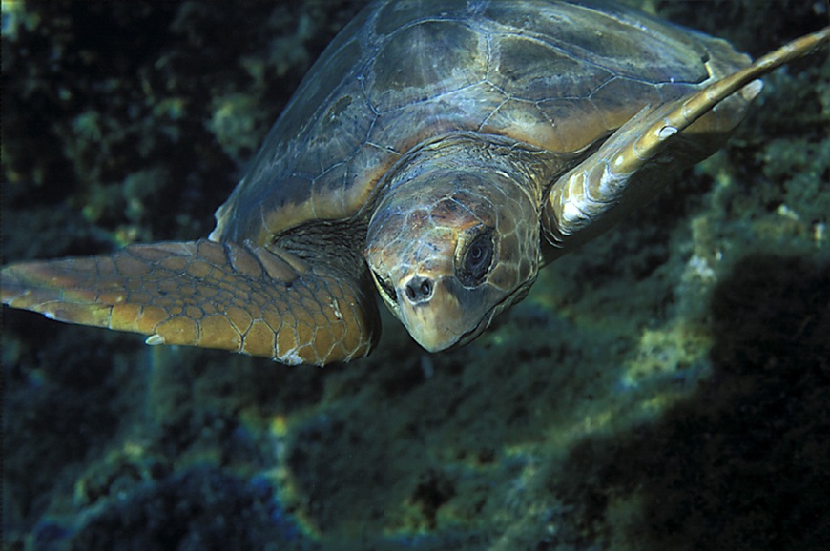
http://siaram.azores.gov.pt/
http://siaram.azores.gov.pt/
Total budget: 19 087 522 €
EC LIFE financial contribution: 11 452 513 € (60%)

Slide 4
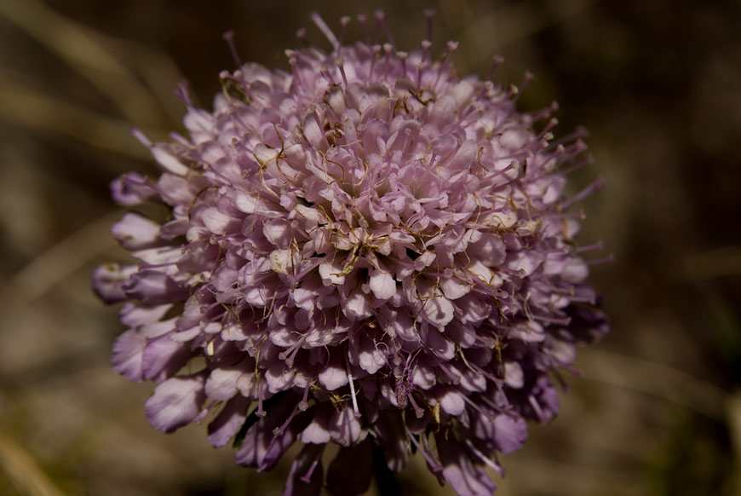
Budget breakdown per category
http://siaram.azores.gov.pt/

Slide 5
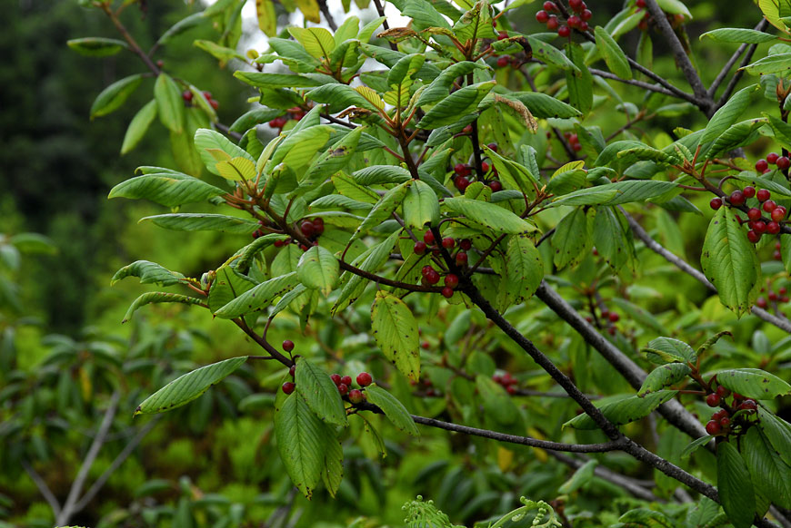
http://siaram.azores.gov.pt/
Complimentary funds: More than 12M€:
89,3% “EU Funding” (EMFF, INTERREG MAC, ERDF, EARDF and LIFE);
3,6% of “Other Public Funds” (national/regional funding)
7,1% of “Private Funds” (from international origin)

Slide 6
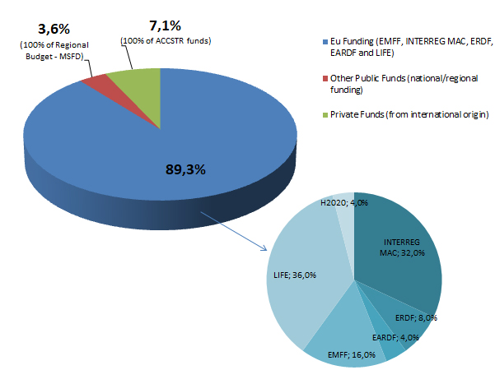
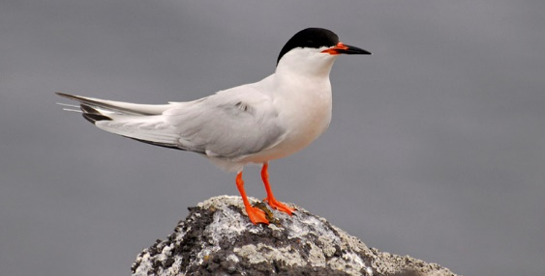
Complimentary Funds
Total: 12 285 114€
3 927 885€ (projects already granted);
7 720 842€ (projects submitted and to be granted);
636 386€ (projects that beneficiaries expect to submit to forthcoming calls – i.e. not yet submited, but already in preparation;

Slide 7
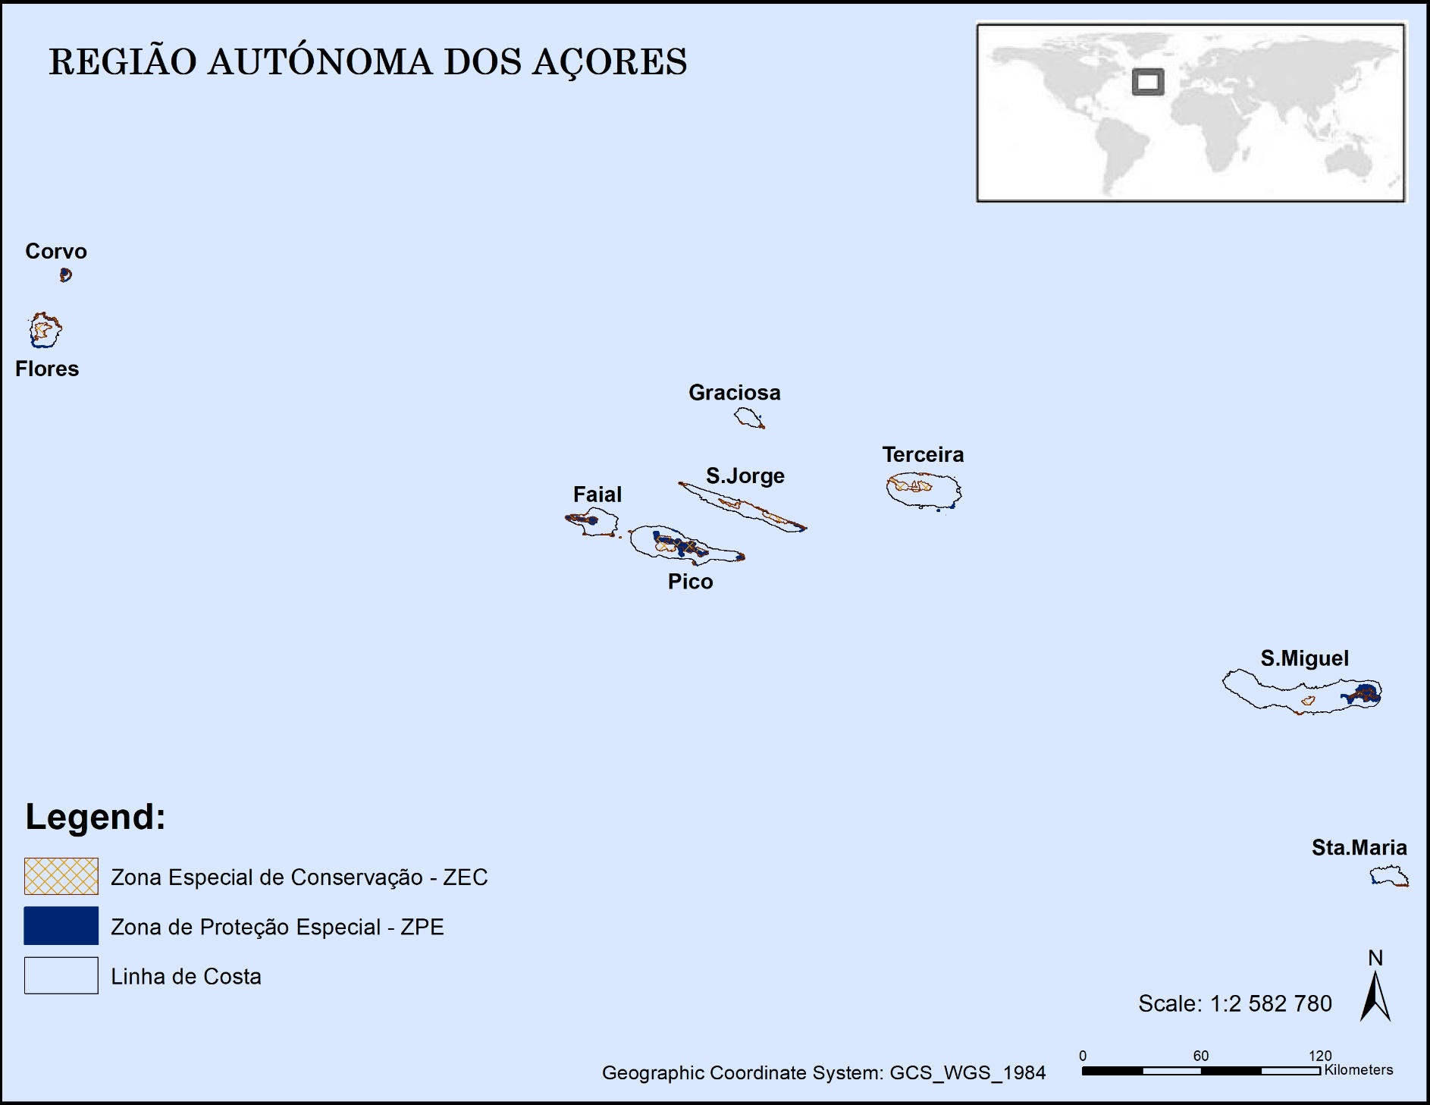
Geography/Project Area

Slide 8
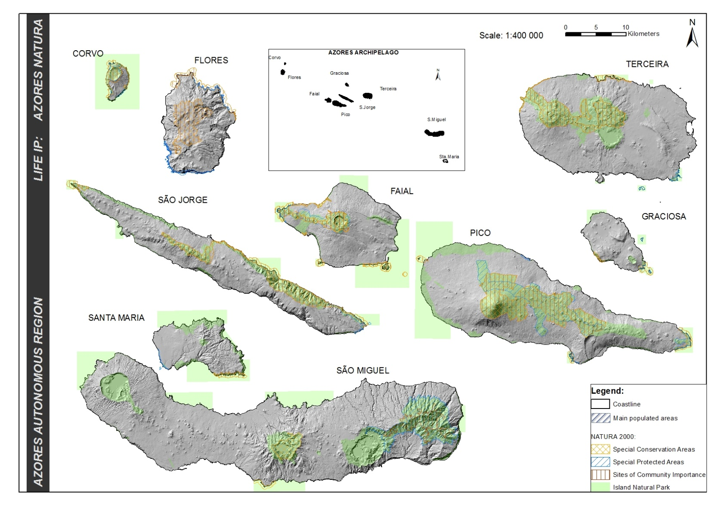
Geography/Project Area

Slide 9
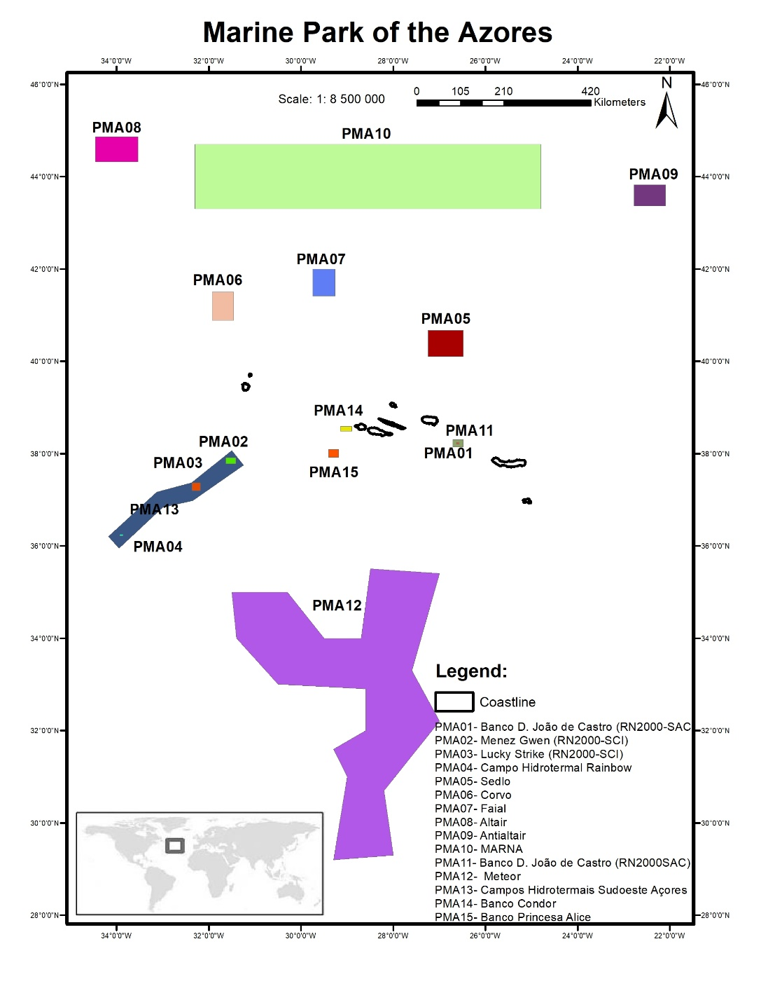
Geography/Project Area

Slide 10
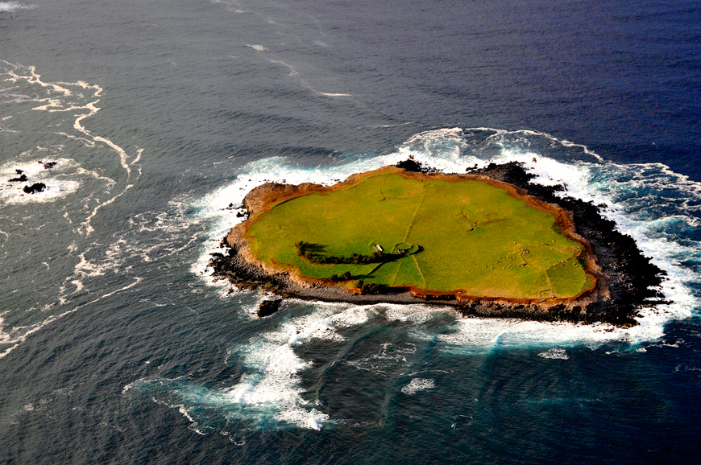
Beneficiaries
Direção Regional do Ambiente (DRA)
(Coordinating Beneficiary)
Fundación Canaria – Reserva Mundial de la Biosfera La Palma (LA PALMA)
Sociedade Portuguesa para o Estudo das Aves (SPEA)
Direção Regional dos Assuntos do Mar (DRAM)
Sociedade de Gestão e Conservação da Natureza (AZORINA)
http://siaram.azores.gov.pt/

Slide 11
BUDGET per Beneficiary
Total Budget | Beneficiaries contribution | EU Contribution
19 087 522€ | 7 635 009€ | 11 452 513€

Slide 12
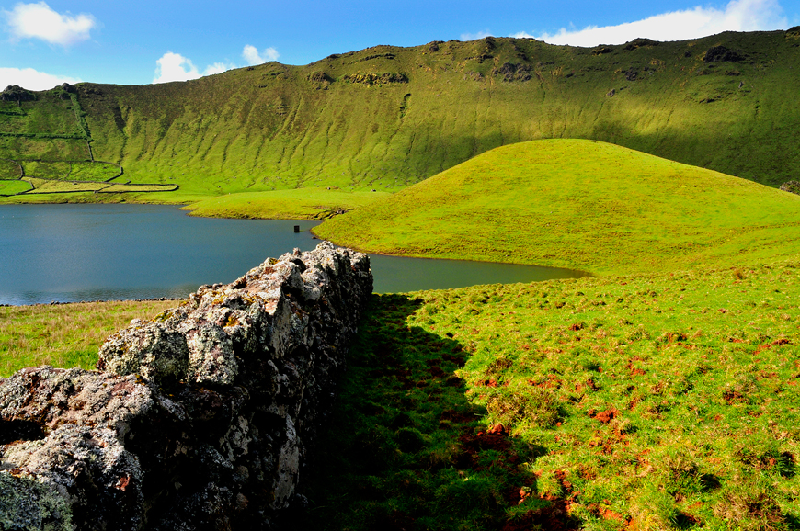
Stakeholders engagement
European Commision
Regional Government
Policy coordination and implementation
Focal point Reporting
LIFE IP Azores Natura
Scientific experience
and technical
support
Scientific Experts and organisation
Sea users representatives
Technical support; marine activity experience; involvement in habitat/species conservation
Experience sharing; awareness; capacity
Experience sharing/capacity building; involvement in habitat/species conservation
Land users representatives
and site managers
Local authorities
http://siaram.azores.gov.pt/

Slide 13
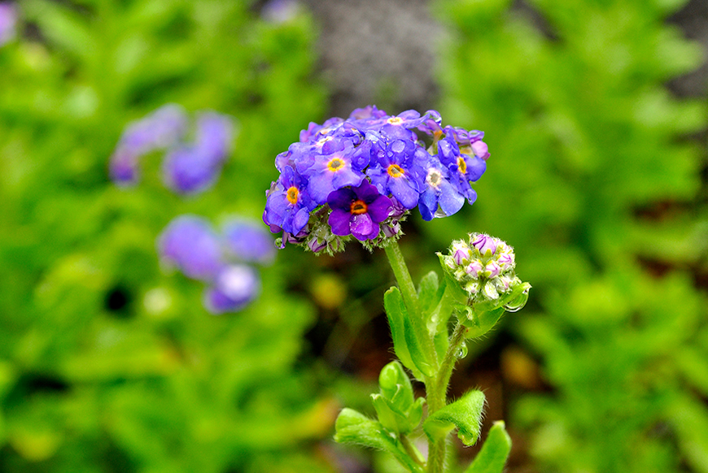
Objectives
Implementation of the regional Prioritized Action Framework (PAF)
Better conservation or a secure status for 100% of habitats and 50% or more of species (those described in unfavourable status on the last reporting to the EU)
Mobilization of complementary funding
Development, testing, demonstration and application of concrete conservation methods with appropriate communication, awareness raising, networking and technical dissemination
http://siaram.azores.gov.pt/

Slide 14
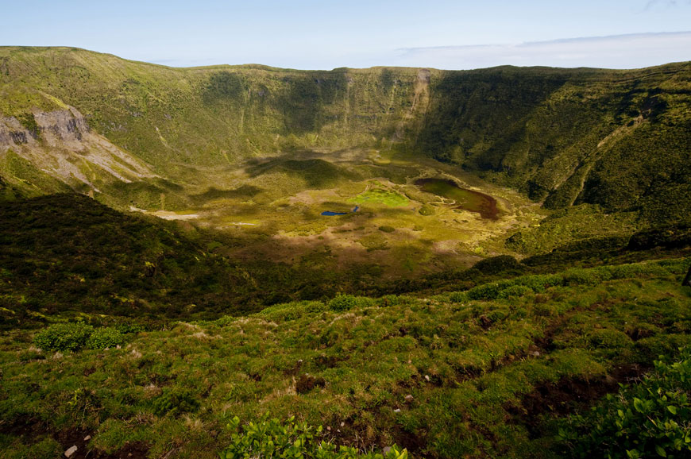
Ecological targets
8 HD protected species (currently assessed in Unfavourable/Bad - U2)
10HD protected species (currently assessed in Unfavourable/Inadequate – U1)
3 HD protected species (currently assessed as Unknown – XX)
3 HD protected habitats (currently assessed in Unfavourable/Bad – U2)
6 HD protected habitats (currently assessed in Unfavourable/Inadequate – U1)
8 BD protected species (1 terrestrial, 7 seabirds) needing improvement of their habitats to secure results obtained with former conservation.
http://siaram.azores.gov.pt/

Slide 15
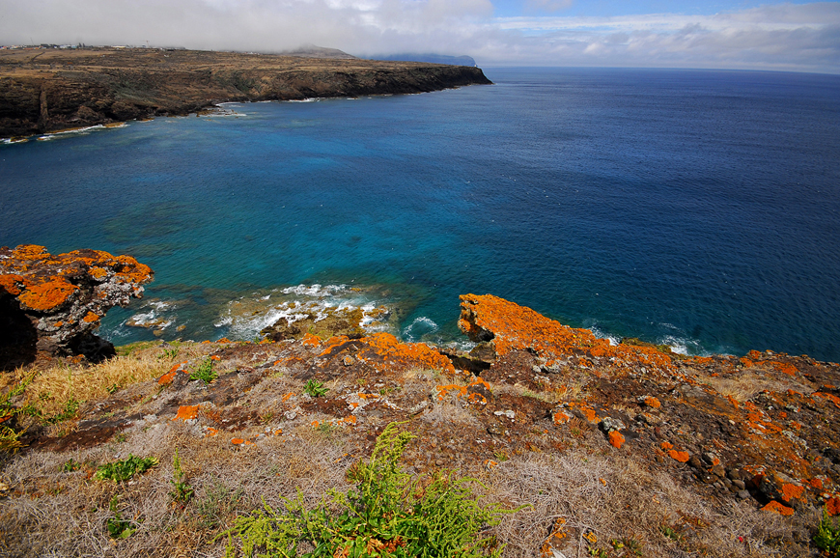
ACTIONS
Preparatory Actions
A1: review and synthesis of technical studies and concrete conservation know-how on conservation practices to be implemented/use: technical planning; permit procedures and stakeholder consultations;
A2 and A3: data gathering and modelling, followed by setting up of integrated georeferenced databases;
A4: additional planning/monitoring activities for full and effective implementation of the PAF:
Designation of 2 new SCI’s islets (Ilhéu do Topo in S.Jorge Island and Ilhéu da Vila in Sta. Maria Island);
Adjustmend, with increase of area, of the existing SAC of Caldeira and Capelinhos – PTFAI0004;
Designation of new off-shore marine SCI’s;
Revision of the PAF;
Regional action plans for some species (focusing on those for which the IP concentrated on knowledge gaps and those requiring active conservation works on the post-project).
http://siaram.azores.gov.pt/
Notes:
AZORES NATURA is expected to focus on conservation problems identified by the PAF at the regional scale. Unser such context, most of the proposed actions involve implementation of best practice works that, due to insufficient resources, have only been applied at smaller scale and/or which are known to be the cost-effective way to deal with existing problems. At the same time, the IP also includes a small set of actions of demonstrative or innovative/pilot nature which are needed to find the best solution to problems that have not been resolved so far at the given scale (e.g. recovery of endemic flora populations), or under the given conditions (e.g. the use of biodegradable lines for recreational fisheries). In addition, to ensure sustainability, capacity building and governance elements are also widely foreseen, to allow for an efficient and well-co-ordinated implementation of the PAF, within the partnership and with external stakeholders. Last but not the least, and to ensure effective replicability/transferability of the core actions, this version of AZORES NATURA includes actions dealing with leveraging replication/transfer of project works, within the project timeframe and after its end, to other public authorities from Macaronesia in charge of N2000. Under such context, we highlight the presence of an associated beneficiary from the Canary Islands, which will be working with IAS prevention, control and eradication works targeting IAS that are also a threat in Azores.
Taking for basis the project objectives, its main actions are described below, following main LIFE categories. Details on each action will be presented in the full proposal.
A. Preparatory Actions: these include works directed at preparing C actions (to be conducted in the initial phase) and a set of works that will prepare the post-project (to be conducted along the project and mostly in the last phase, including legal approval of the applicable plans). Those to be executed at the initial phase include:

Slide 16
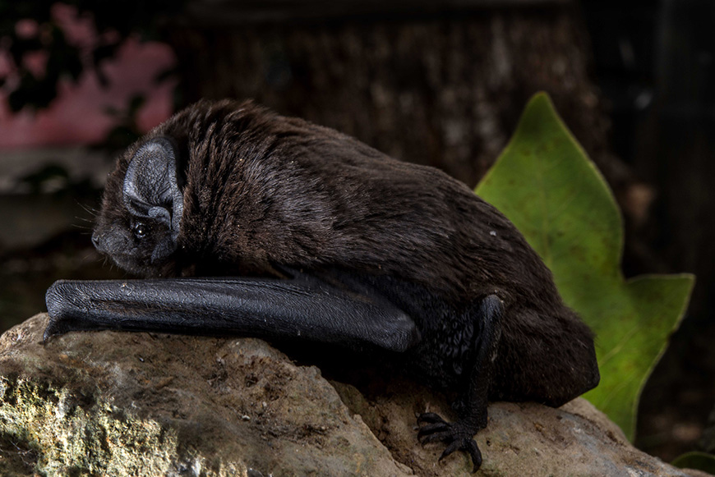
ACTIONS
Concrete Conservation Actions
C1: Land purchase for recovery of habitats under unfavourable status.
C2: Promotion of extensive capacity building
C3, C4, C5 and C6: restoration and conservation of terrestrial habitats, habitats for birds and wild populations of threatened flora
C7: Gathering additional information about Nyctalus azoreum, having for target definition of appropriate conservation measures for this species.
http://siaram.azores.gov.pt/

Slide 17
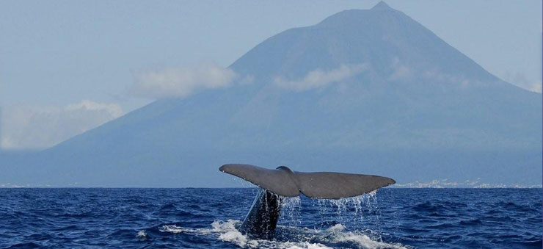
ACTIONS
Concrete Conservation Actions
C8, C11 and C12: prevention of introduction/expansion, control and eradication of IAS and NIS
C9: Conservation of marine species:
Best-practice for conservation of marine turtles Caretta caretta* and Chelonia mydas*
Reduction of impacts from ship traffic and underwater noise on protected cetaceans
C10: restoration and conservation of coastal and marine habitats:
best practice works dealing with removal of fishing gear and marine litter from coastal reefs (1170)
Improvement of off-shore and coastal use through design/implementation of conduct codes and increased surveillance.

Slide 18
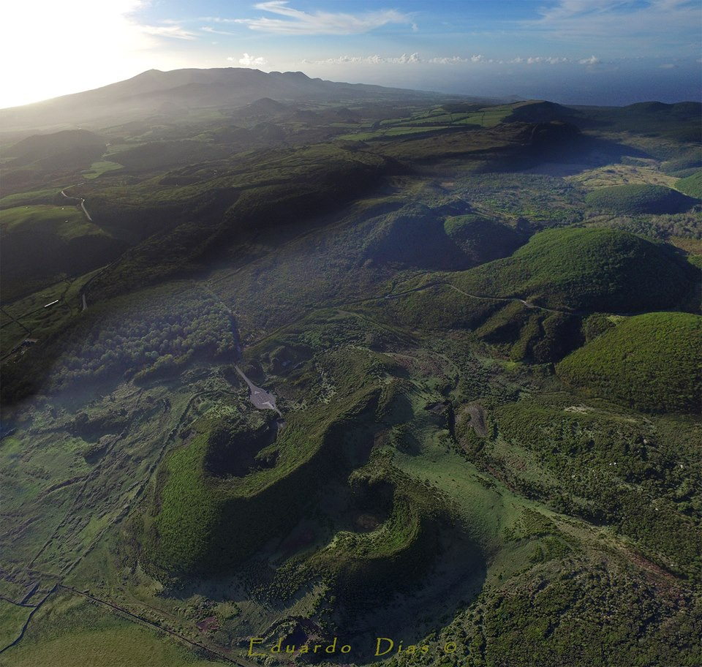
ACTIONS
Concrete Conservation Actions
C13 until C16: improvement of integration of N2000 conservation with agriculture, tourism, fisheries and marine transport.
Notes:
a) pilot solutions for regular advice on EU funding;
b) demonstration/application of solutions for minimizing agricultural impacts, in link with other
Implementation of best practice and demonstration solutions for management of pedestrian tourism, directed at improving/creating/managing nature trails
Regulation and voluntary instruments for reducing impacts of whale watching, diving, and related marine torusim activities.
Pilot solutions for promotion of use of biodegradable gear on recreational fisheries
Pilot solutions for regular advice on EU funding.
Pilot solutions for promotion of use of biodegradable gear on recreational fisheries
Pilot solutions for regular advice on EU funding.

Slide 19
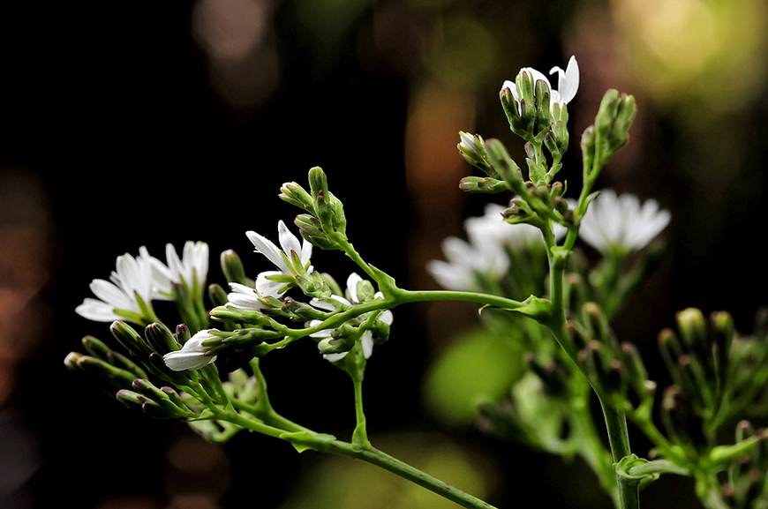
ACTIONS
Monitoring of the impact of project actions
D1: monitoring the project’s impact on LIFE IP Performance Indicators
D2: monitoring the project’s contribution to the implementation of the PAF
D3: monitoring the project’s socio-economic impact
D4: monitoring effects on ecosystem functions/services
D5: monitoring the project concrete results on habitats, species and conservation problems, directly targeted with conservation works.
http://siaram.azores.gov.pt/

Slide 20
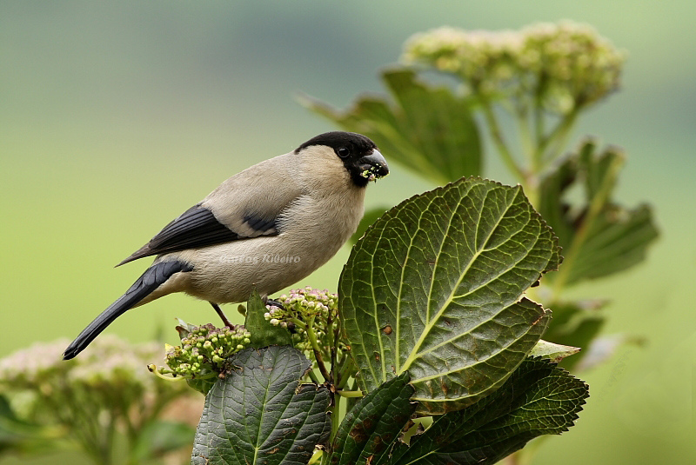
ACTIONS
Communication and dissemination actions
E1: implementing/delivering obligatory components of the Communication Plan: 1) project website; 2) noticeboards; 3) Layman’s report; 4) Specific communication plan for public awareness, including regular work with the media.
E2: technical dissemination,transfer and replication of project works
E3: networking activities with other LIFE and/or non-LIFE projects
E4: environmental education program, to raise awareness in schools.
E5: general public engagement in conservation works.

Slide 21
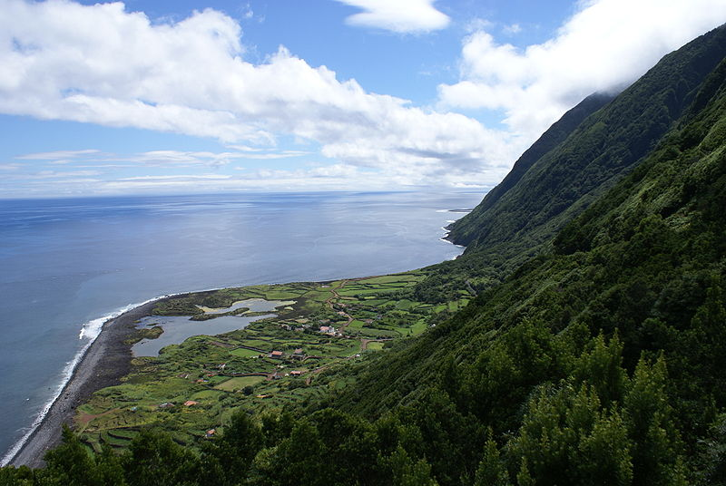
ACTIONS
Project management and monitoring of project progress
F1: overall project management (including External Audit)
F2: update/regular delivery of phase/stage planning and monitoring project progress
F3: working group for coordination of complimentary funds
F4: operation of governance boards, including a technical advisory and a stakeholder board
F5: drafting, discussion and approval of After-LIFE plan.

Slide 22
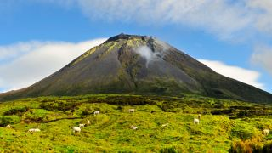
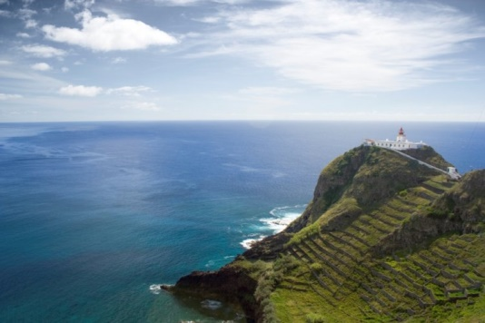
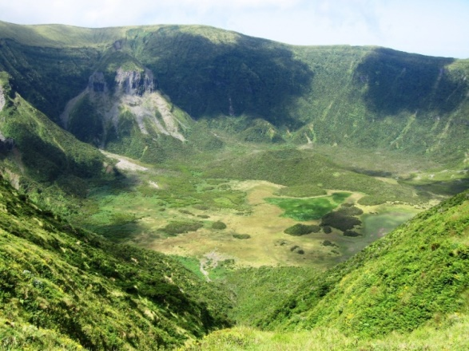
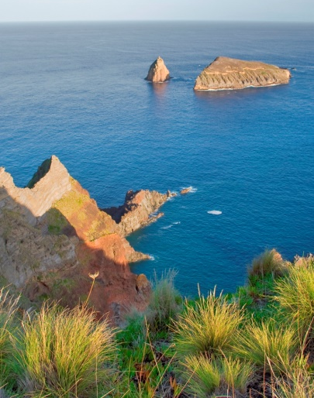
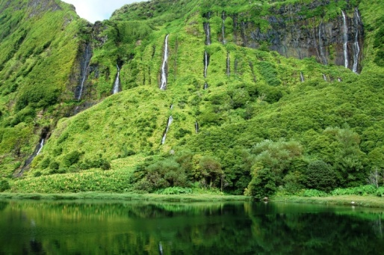
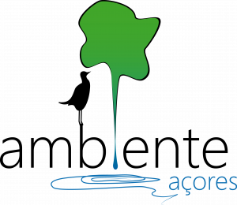
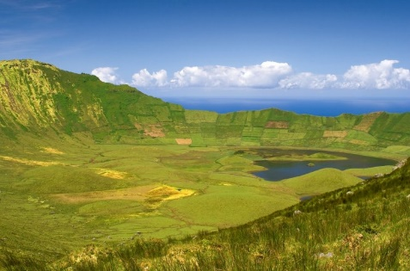
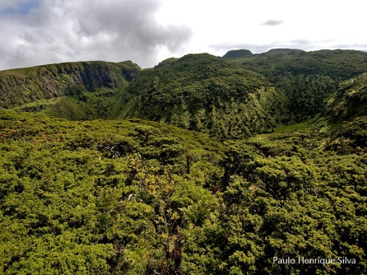
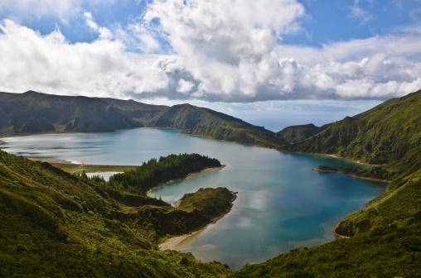
LIFE AZORES NATURA
LIFE 17 IPE/PT 0010
Diana Pernes
Diana.CP.Pernes@azores.gov.pt
Thank you!

