Slide 1
Active protection and integrated management of Natura 2000 Network in Azores LIFE IP AZORES NATURA – LIFE 17 IPE/PT 0010
Universidade dos Açores
http://siaram.azores.gov.pt/
DIANA PERNES
Diana.CP.Pernes@azores.gov.pt
Ponta Delgada, April 30th, 2019

Slide 2
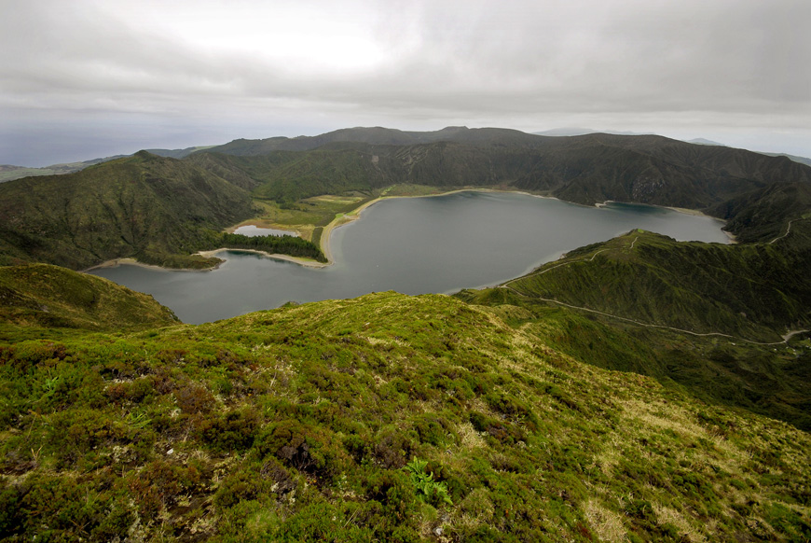
Active protection and integrated management of Natura 2000
Network in Azores
LIFE IP AZORES NATURA – LIFE 17 IPE/PT 000010
Duration:
9 anos (01/01/2019 a 31/12/2027)
Total Budget:
19 087 522€
EC Co-funding:
11 452 513€ (60%)
Complementary Funds:
12 M€
Coordinating Beneficiary:
Direção Regional do Ambiente
http://siaram.azores.gov.pt/
Associated Beneficiaries:
Direção Regional dos Assuntos do Mar
Sociedade de Gestão e Conservação da Natureza - AZORINA
Sociedade Portuguesa para o Estudo das Aves - SPEA
Fundación Canaria Reserva Mundial de La Biosfera La Palma

Slide 3
Active protection and integrated management of Natura 2000
Network in Azores
LIFE IP AZORES NATURA – LIFE 17 IPE/PT 000010
Budget per Beneficiary
Total Budget | Beneficiaries contribution | EU Contribution
19 087 522€ | 7 635 009€ | 11 452 513€

Slide 4
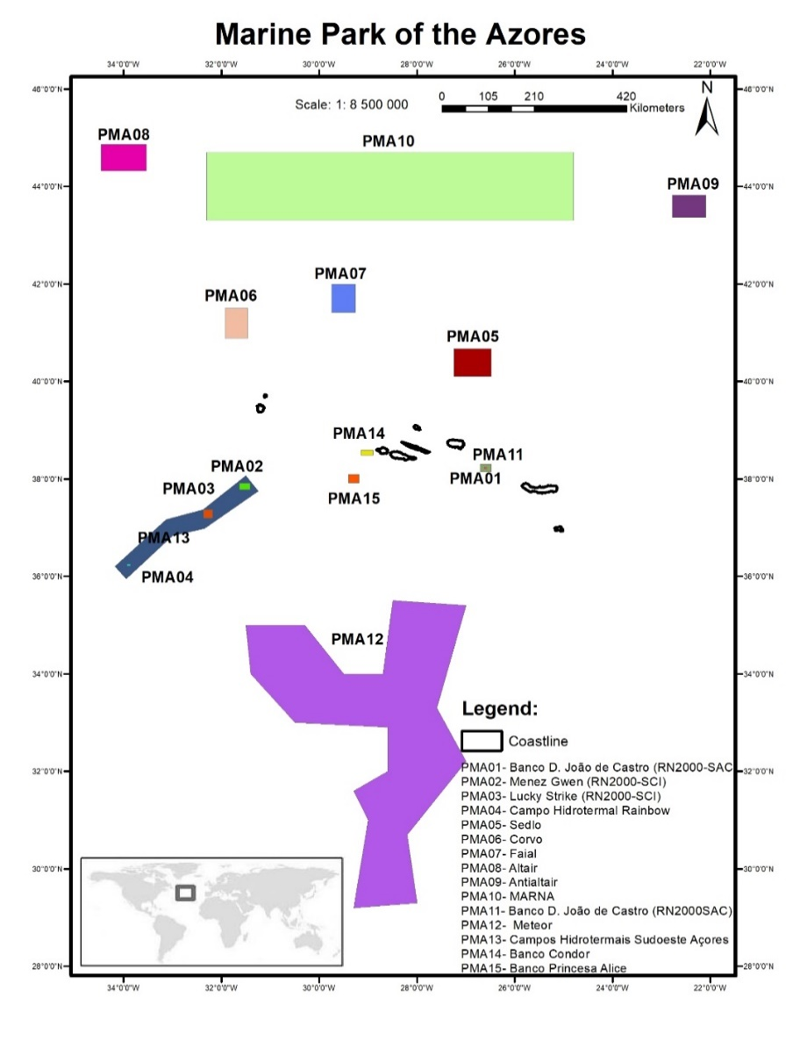
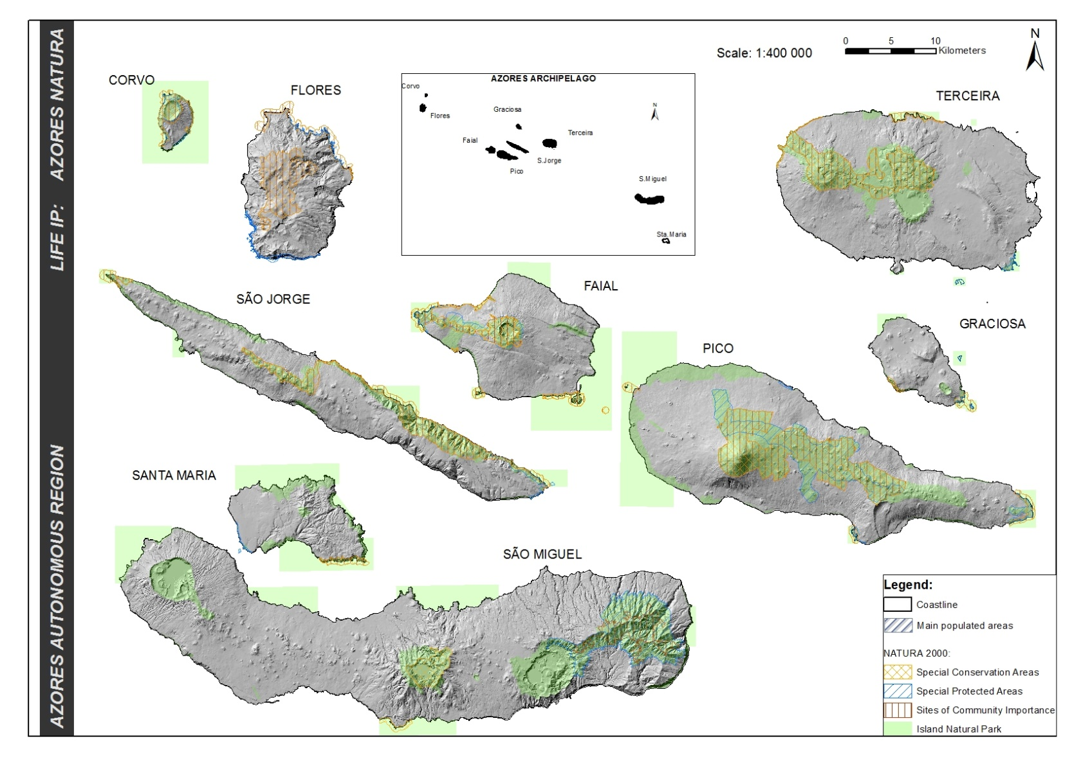
Active protection and integrated management of Natura 2000
Network in Azores
LIFE IP AZORES NATURA – LIFE 17 IPE/PT 000010
Project Area [Covers all Natura 2000 Network in Azores (23 SAC; 15 SPA; 3 SCI)]

Slide 5
Active protection and integrated management of Natura 2000
Network in Azores
LIFE IP AZORES NATURA – LIFE 17 IPE/PT 000010
Objectives & Scope:
Implementation of the Regional Prioritized Action Framework (PAF);
Improve the conservation status for 100% of habitats and 50% or more of species (those described in unfavourable status on the last reporting to the EU;
Mobilization of complimentary funding, through other available funds, in the management of N2000 sites in the Azores.

Slide 6
Active protection and integrated management of Natura 2000
Network in Azores
LIFE IP AZORES NATURA – LIFE 17 IPE/PT 000010
Actions:
Best Practice Actions
(eg.: Regional Strategy for IAS; Regional Strategy for Prevention and Control of marine IAS;
Restoration of habitats under HD; Conservation of marine turtles; Conservation of Azores bullfinch;
Demonstrative/Innovative Works
(recovery of endemic flora populations; Pilot action for early warning and rapid response for IAS)
- Capacity Building; -Governance; - Stakeholder’s engagement;
- Support office for mobilization of complementary funds;
Replicability and transferability of project works
(pilot action with Canary islands and transfer of knowledge to other regions of Macaronesia)

Slide 7
Active protection and integrated management of Natura 2000
Network in Azores
LIFE IP AZORES NATURA – LIFE 17 IPE/PT 000010
Policies Implemented
Implementation of Prioritized Action Framework (PAF)
EU Biodiversity Strategy targets (target 2, 4, 5 e 6)
Marine Strategy Framework Directive (MSFD descriptors 1, 2,3 6, 10 e 11)
National Strategy for the Seas and National Strategy for Nature Conservation and Biodiversity
Regional Program for Climate Change (PRAC) – EU Climate Adaptation Strategy
- Water Framework Directive - Biosphere Reserves
- RAMSAR Convention

Slide 8
Active protection and integrated management of Natura 2000
Network in Azores
LIFE IP AZORES NATURA – LIFE 17 IPE/PT 000010
Main expected results:
Implementation of PAF for N2000 in Azores, to improve the conservation status of 24 species and 13 habitat types protected under the Birds Directive and the Habitats Directive, including flora and fauna (terrestrial and marine).
Fill knowledge gaps on distribution, conservation status and threats for specific species (flora/fauna) and habitats (eg. Endemic bat – Nyctalus azoreum);
Increase of publicly-owned land within Natura 2000 by 96 ha, for restoration of protected habitats;
Improved habitats over 24 ha for 7 seabird species, and 120 ha for Pyrrhula murina;
Control and awareness for Invasive Alien Species and Non-Indigenous Species ;
Update of information on marine species and designation of new marine sites;
Designation of new SCI’s;

Slide 9
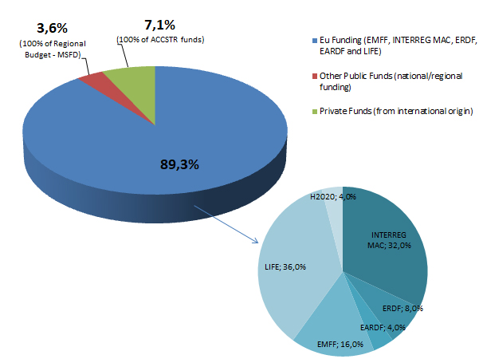
Active protection and integrated management of Natura 2000
Network in Azores
LIFE IP AZORES NATURA – LIFE 17 IPE/PT 000010
Complementary Funds:
Total: 12.3 M€
3 927 885€ (projects already granted)
7 720 842€ (projects submitted and to be granted)
636 386€ (projects that beneficiaries expect to submit to forthcoming calls – i.e. not yet submited, but already in preparation)

Slide 10
Active protection and integrated management of Natura 2000
Network in Azores
LIFE IP AZORES NATURA – LIFE 17 IPE/PT 000010
Complementary Actions and Funds:
Drafting of management plans for sustainability of human activities in open ocean marine protected areas;
Promotion of studies to ensure installation and functioning of monitoring devices on marine noise;
Research works and / or field inventories for databases, also foreseen in PAF, but with better elegibility under other financing mechanisms;
Conservation works for areas outside N2000, but essentials to support the works proposed by LIFE IP, such as control of Invasive Alien Species;
Open desktop offices focused on how to mobilize the several funds to support N2000 and not only (ex. FEDER, …), for agriculture, tourism, fisheries (something specific of the integrated projects and which is only supported because of the complementarity)

Slide 11
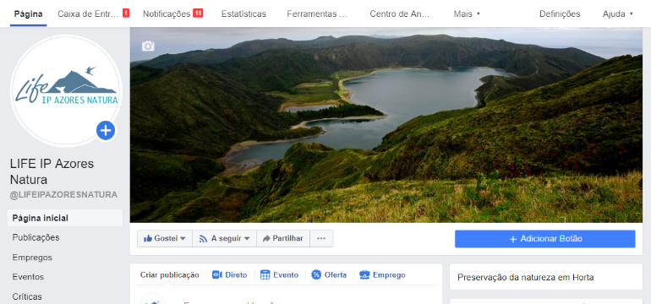
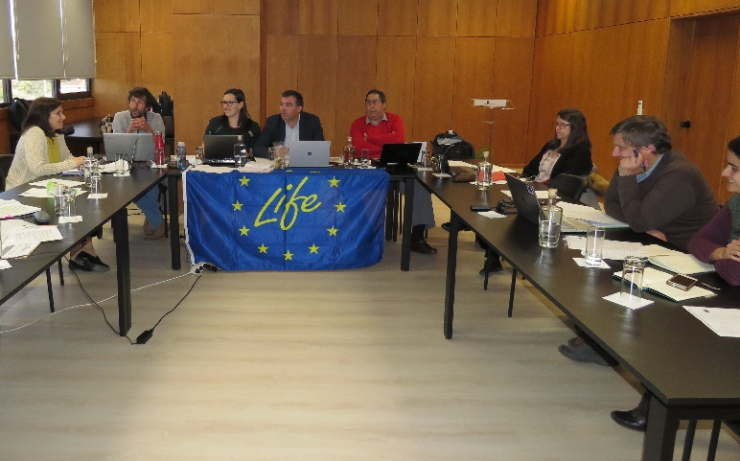
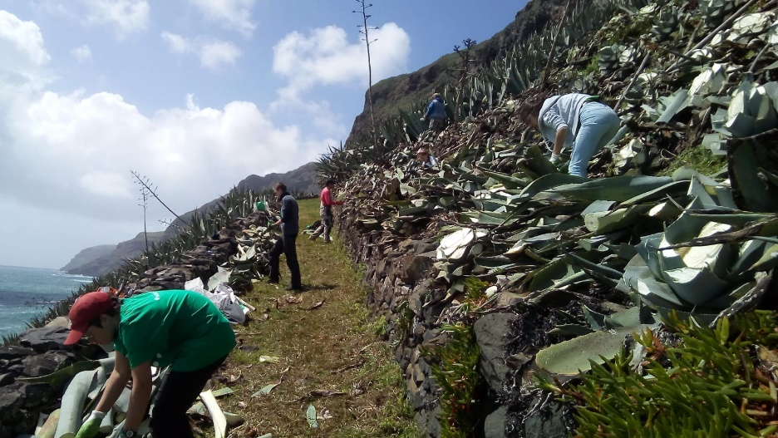
Active protection and integrated management of Natura 2000
Network in Azores
LIFE IP AZORES NATURA – LIFE 17 IPE/PT 000010
Results:
Management meetings with all partners
Creation of project logo and communication plan in development
Internal Capacity Building:
Finantial Training
Training action, in Santa Maria island, in the control of the exotic species, Agave americana, for restoration of the habitat for Lotus azoricus
Procedures for land acquisition in progress
Stakeholder Board and Advisory Board stablished
Hiring of technical and operational teams
Facebook page with 464 likes (at 29/04/2019)
https://www.facebook.com/LIFEIPAZORESNATURA/

Slide 12
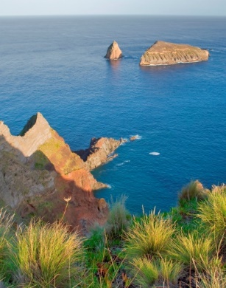
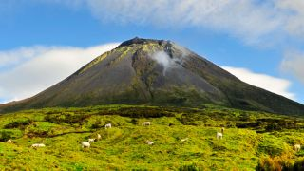
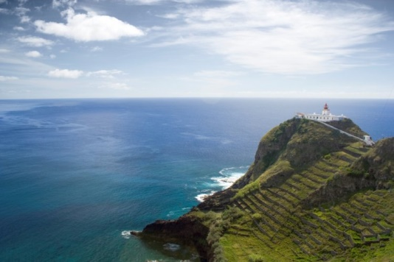
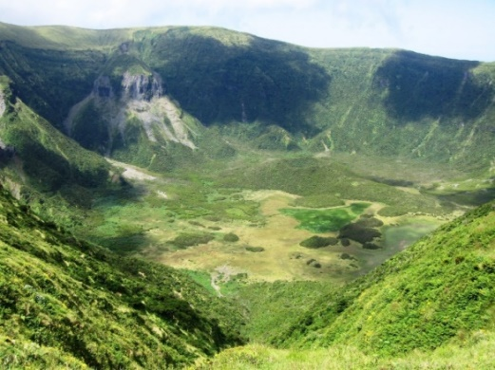
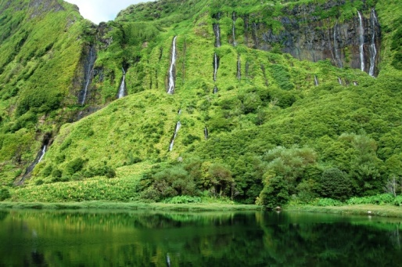
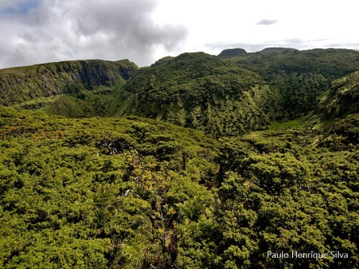
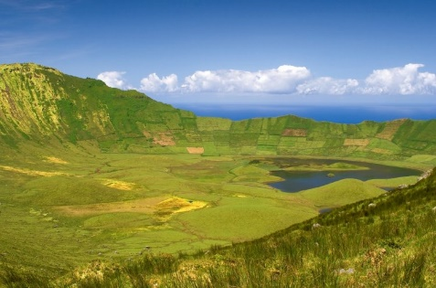
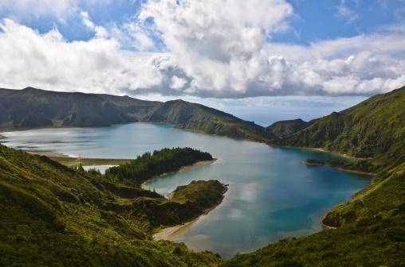
Thank you!
Active protection and integrated management of Natura 2000
Network in Azores
LIFE IP AZORES NATURA – LIFE 17 IPE/PT 000010

