Slide 1
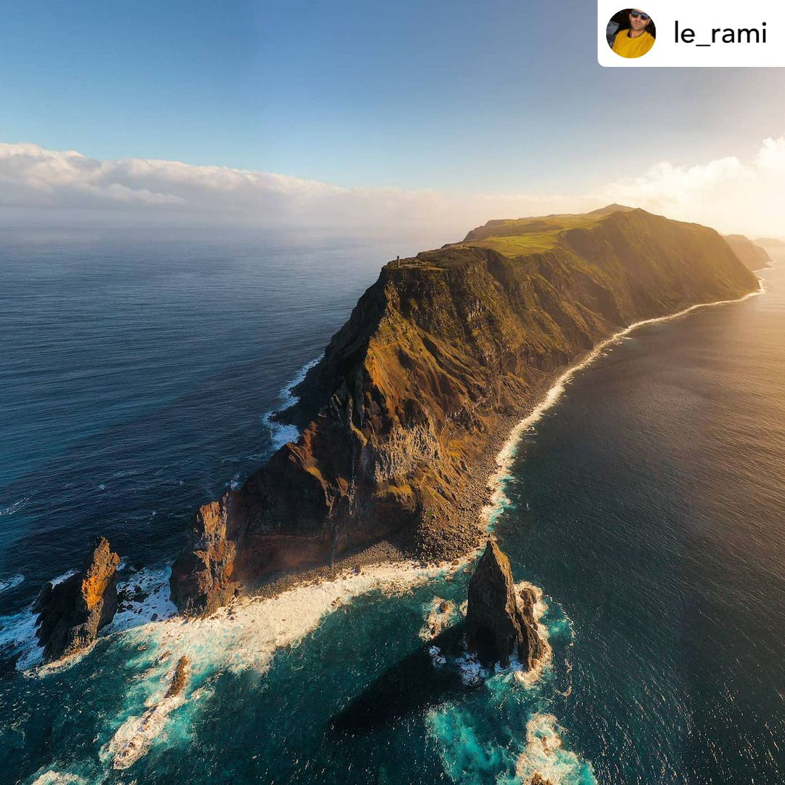
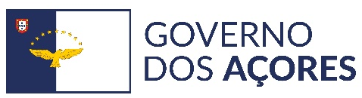

Potential Uses of Coastal Zone cartography to support ongoing LIFE projects in an island context: the case of the Azores
Diana Pereira (Azores Regional Government — Regional Secretariat for Environment and Climate Change)

Slide 2


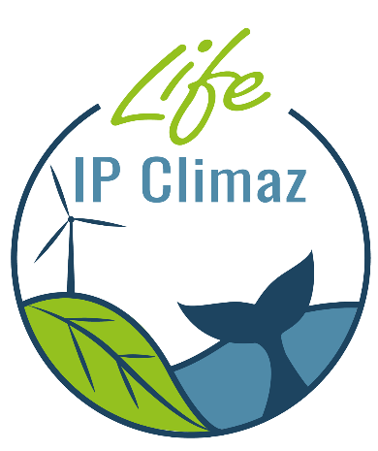
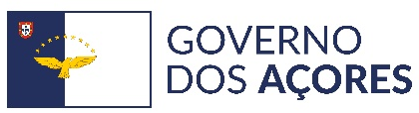


Main Context|Regional Secretariat for Environment and Climate Change – Regional Government of the Azores
Coordination of ongoing LIFE Projects
LIFE VIDALIA – Valorization and innovation for Azorina and Lotus in the azorean islands
LIFE IP AZORES NATURA - Active Protection and Integrated Management of Natura 2000 Network
LIFE BEETLES - Bringing Environmental and Ecological Threats Lower to Endangered Species
LIFE IP CLIMAZ - Regional Program for Climate Change

Slide 3
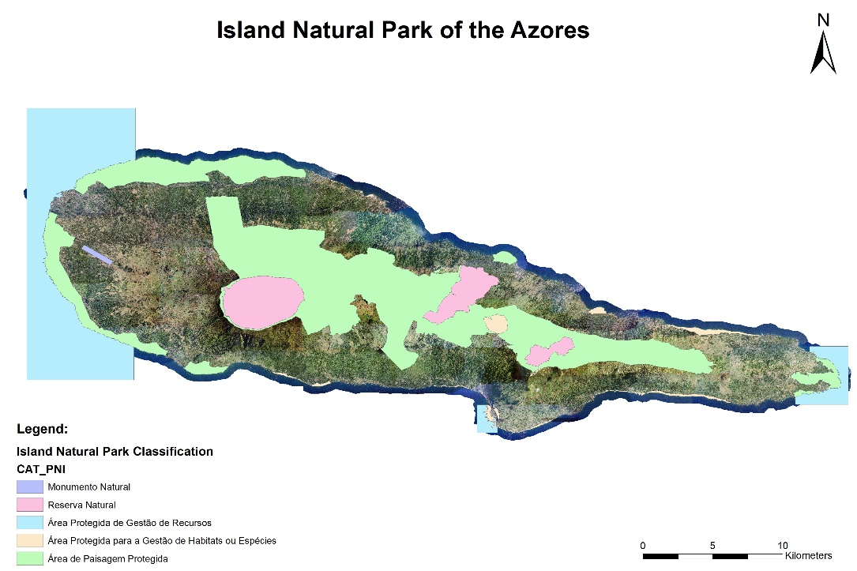
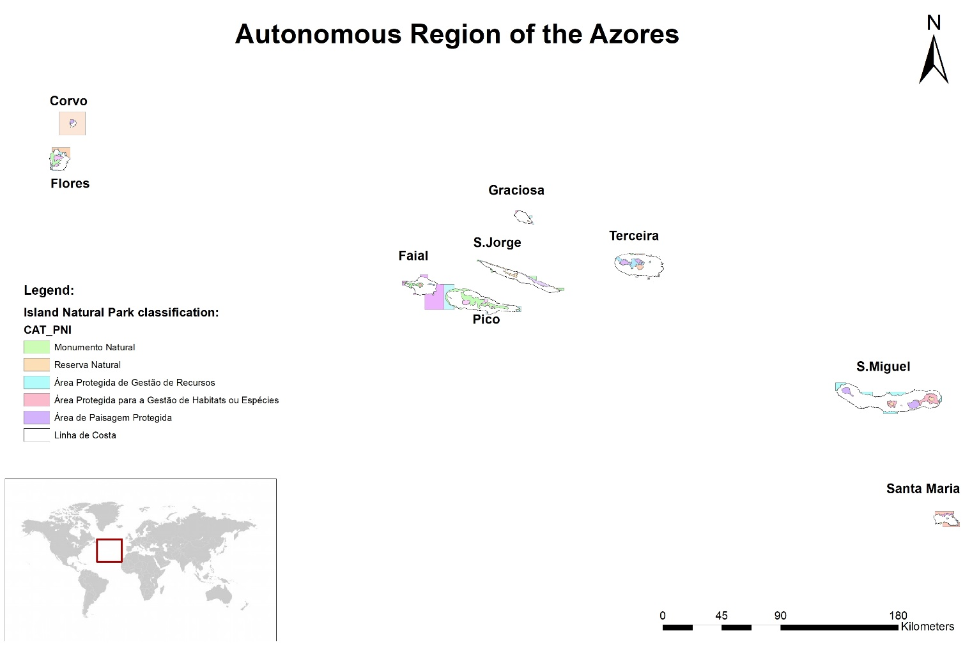
Main Context|Regional Secretariat for Environment and Climate Change – Regional Government of the Azores
Management of Regional Network of Protected Areas of the Azores
Classification of the Regional Network of Protected Areas of the Azores – according to IUCN categories:
Nature Reserve
b) Natural Monument
c) Protected area for the management of habitats or species
Protected landscape area
Protected area of resource management

Slide 4
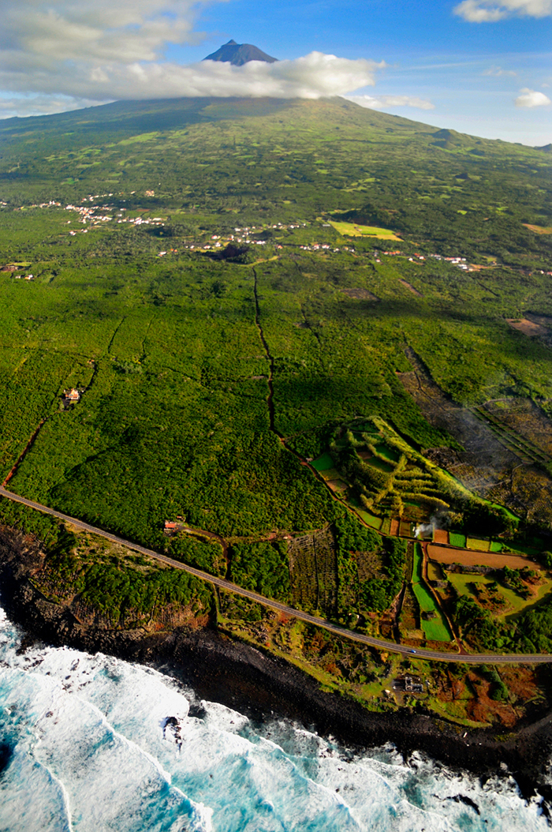

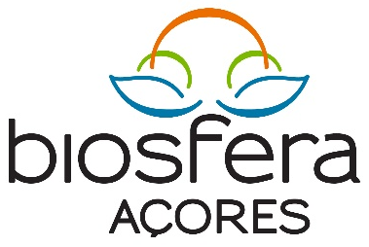
Main context|Regional Secretariat for Environment and Climate Change – Regional Government of the Azores
UNESCO World Heritage:
  Angra do Heroísmo City
  Pico Island Vineyard Culture Landscape
Biosphere Reserves:
  4 Islands classify: S.Jorge, Graciosa, Flores e Corvo
Geopark Azores:
  121 geosites

Slide 5
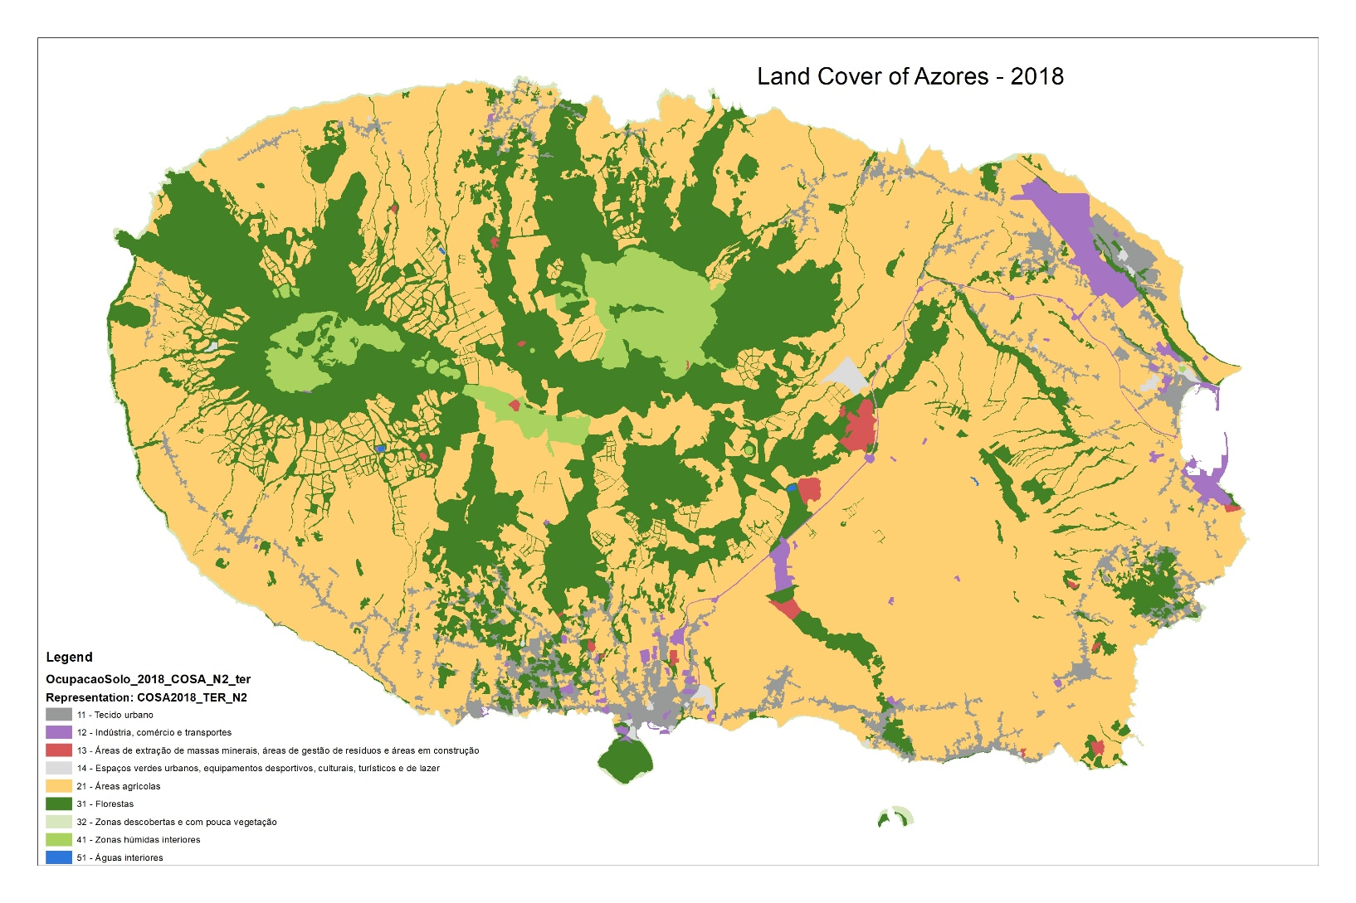
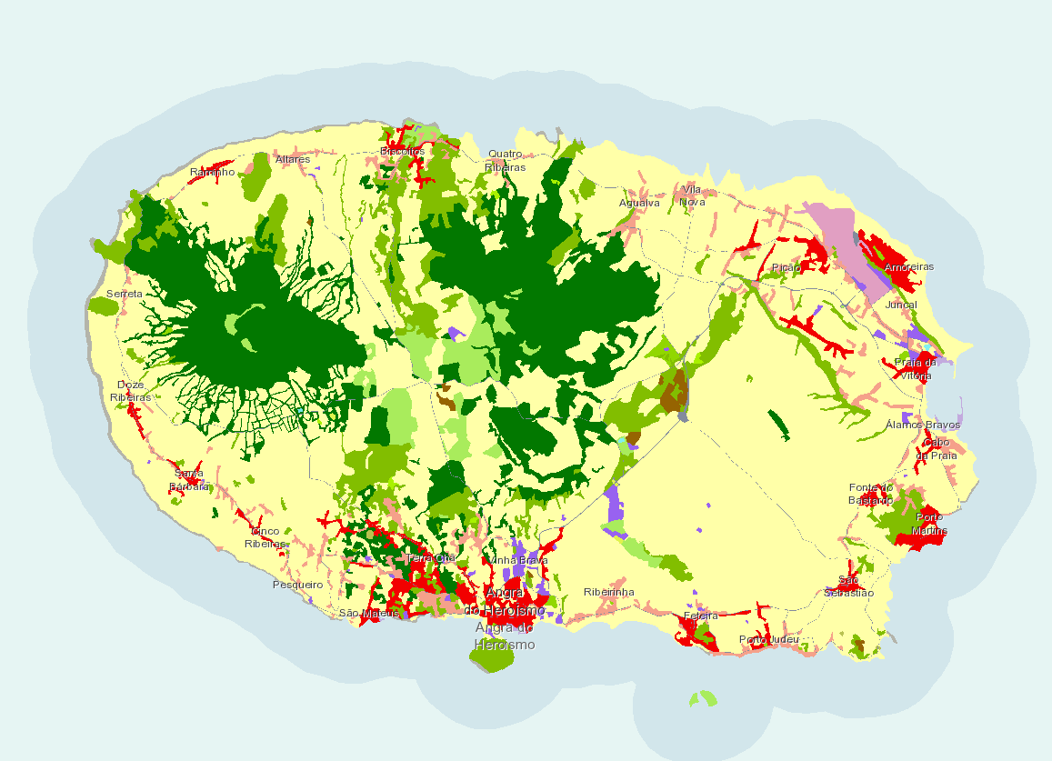
Potential Uses
Support to “validation” of land cover cartography for Azores

Slide 6
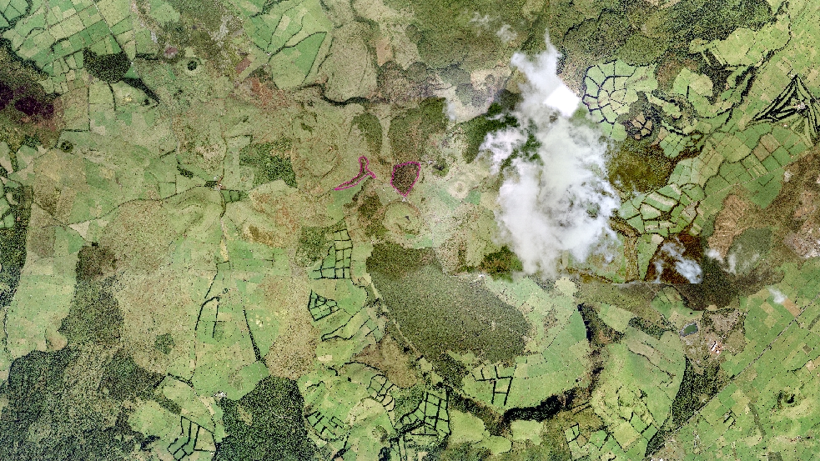
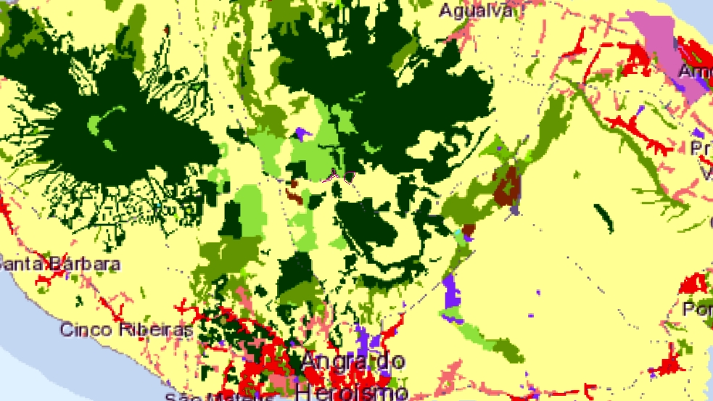
Potential Uses
Support to “validation” and improvement of CZ cartography –
Example of LIFE BEETLES

Slide 7
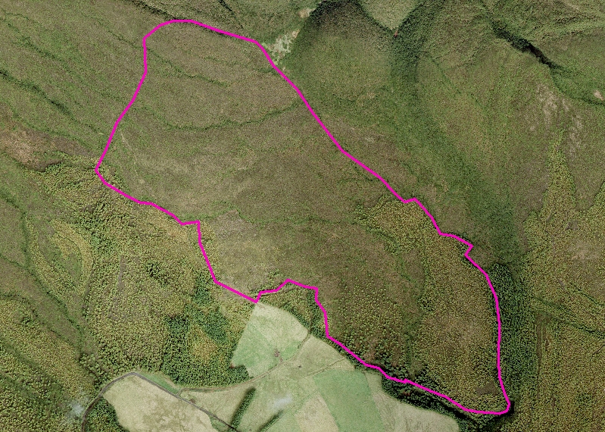
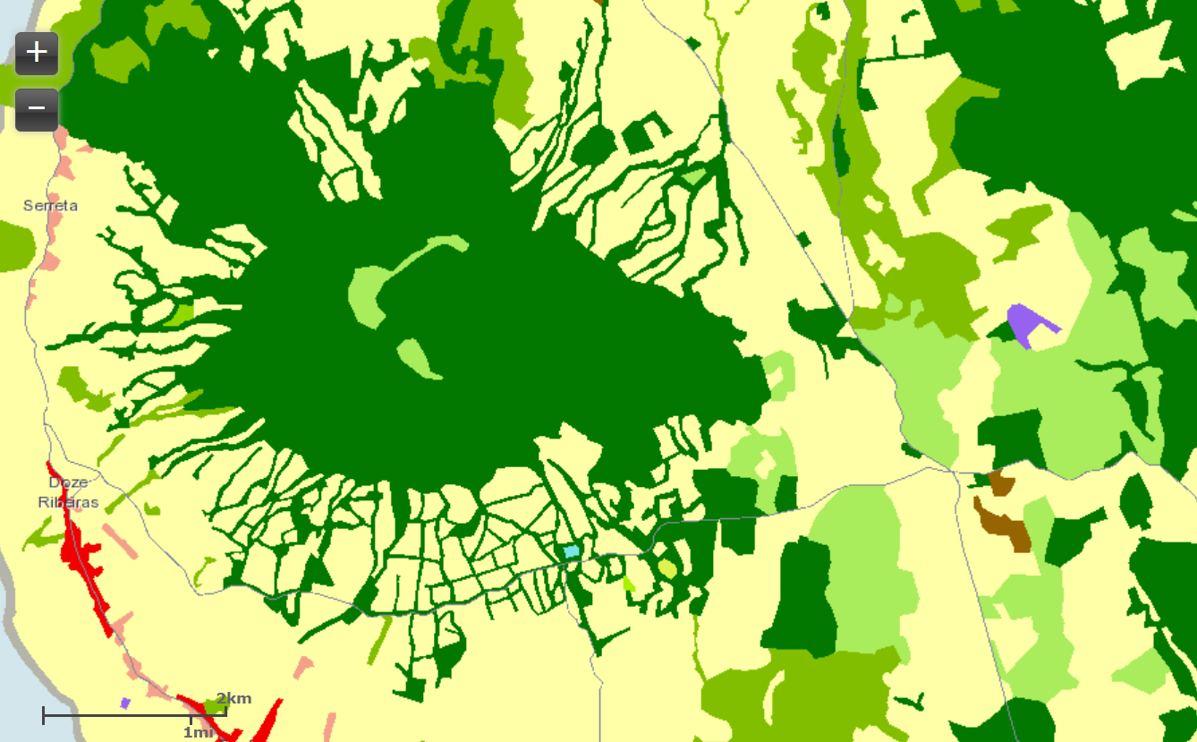
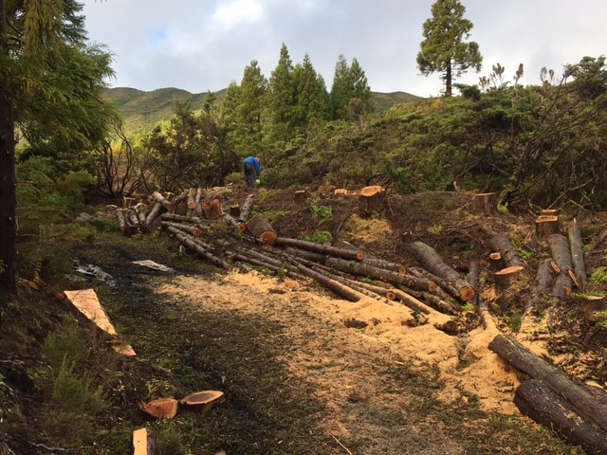
Potential Uses
Support to long-term monitoring of IAS control – LIFE IP AZORES NATURA

Slide 8
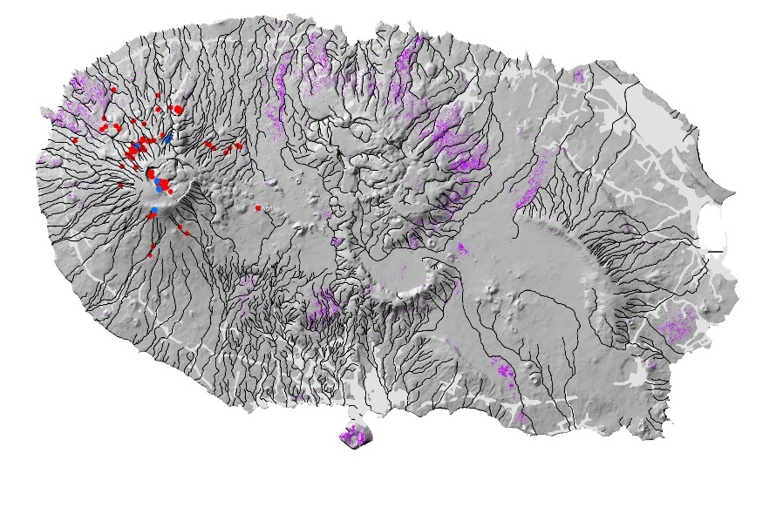
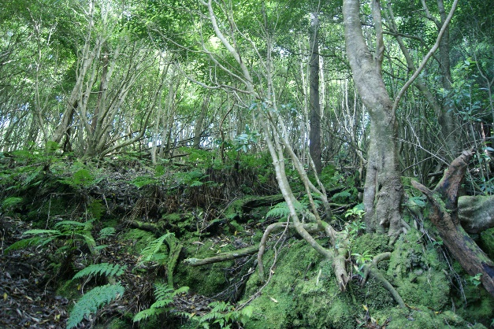
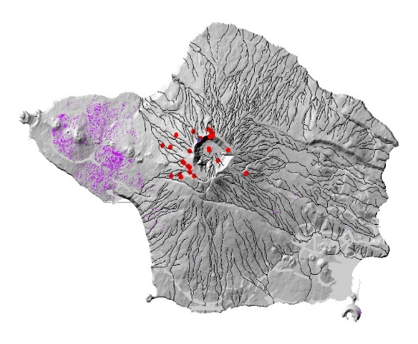
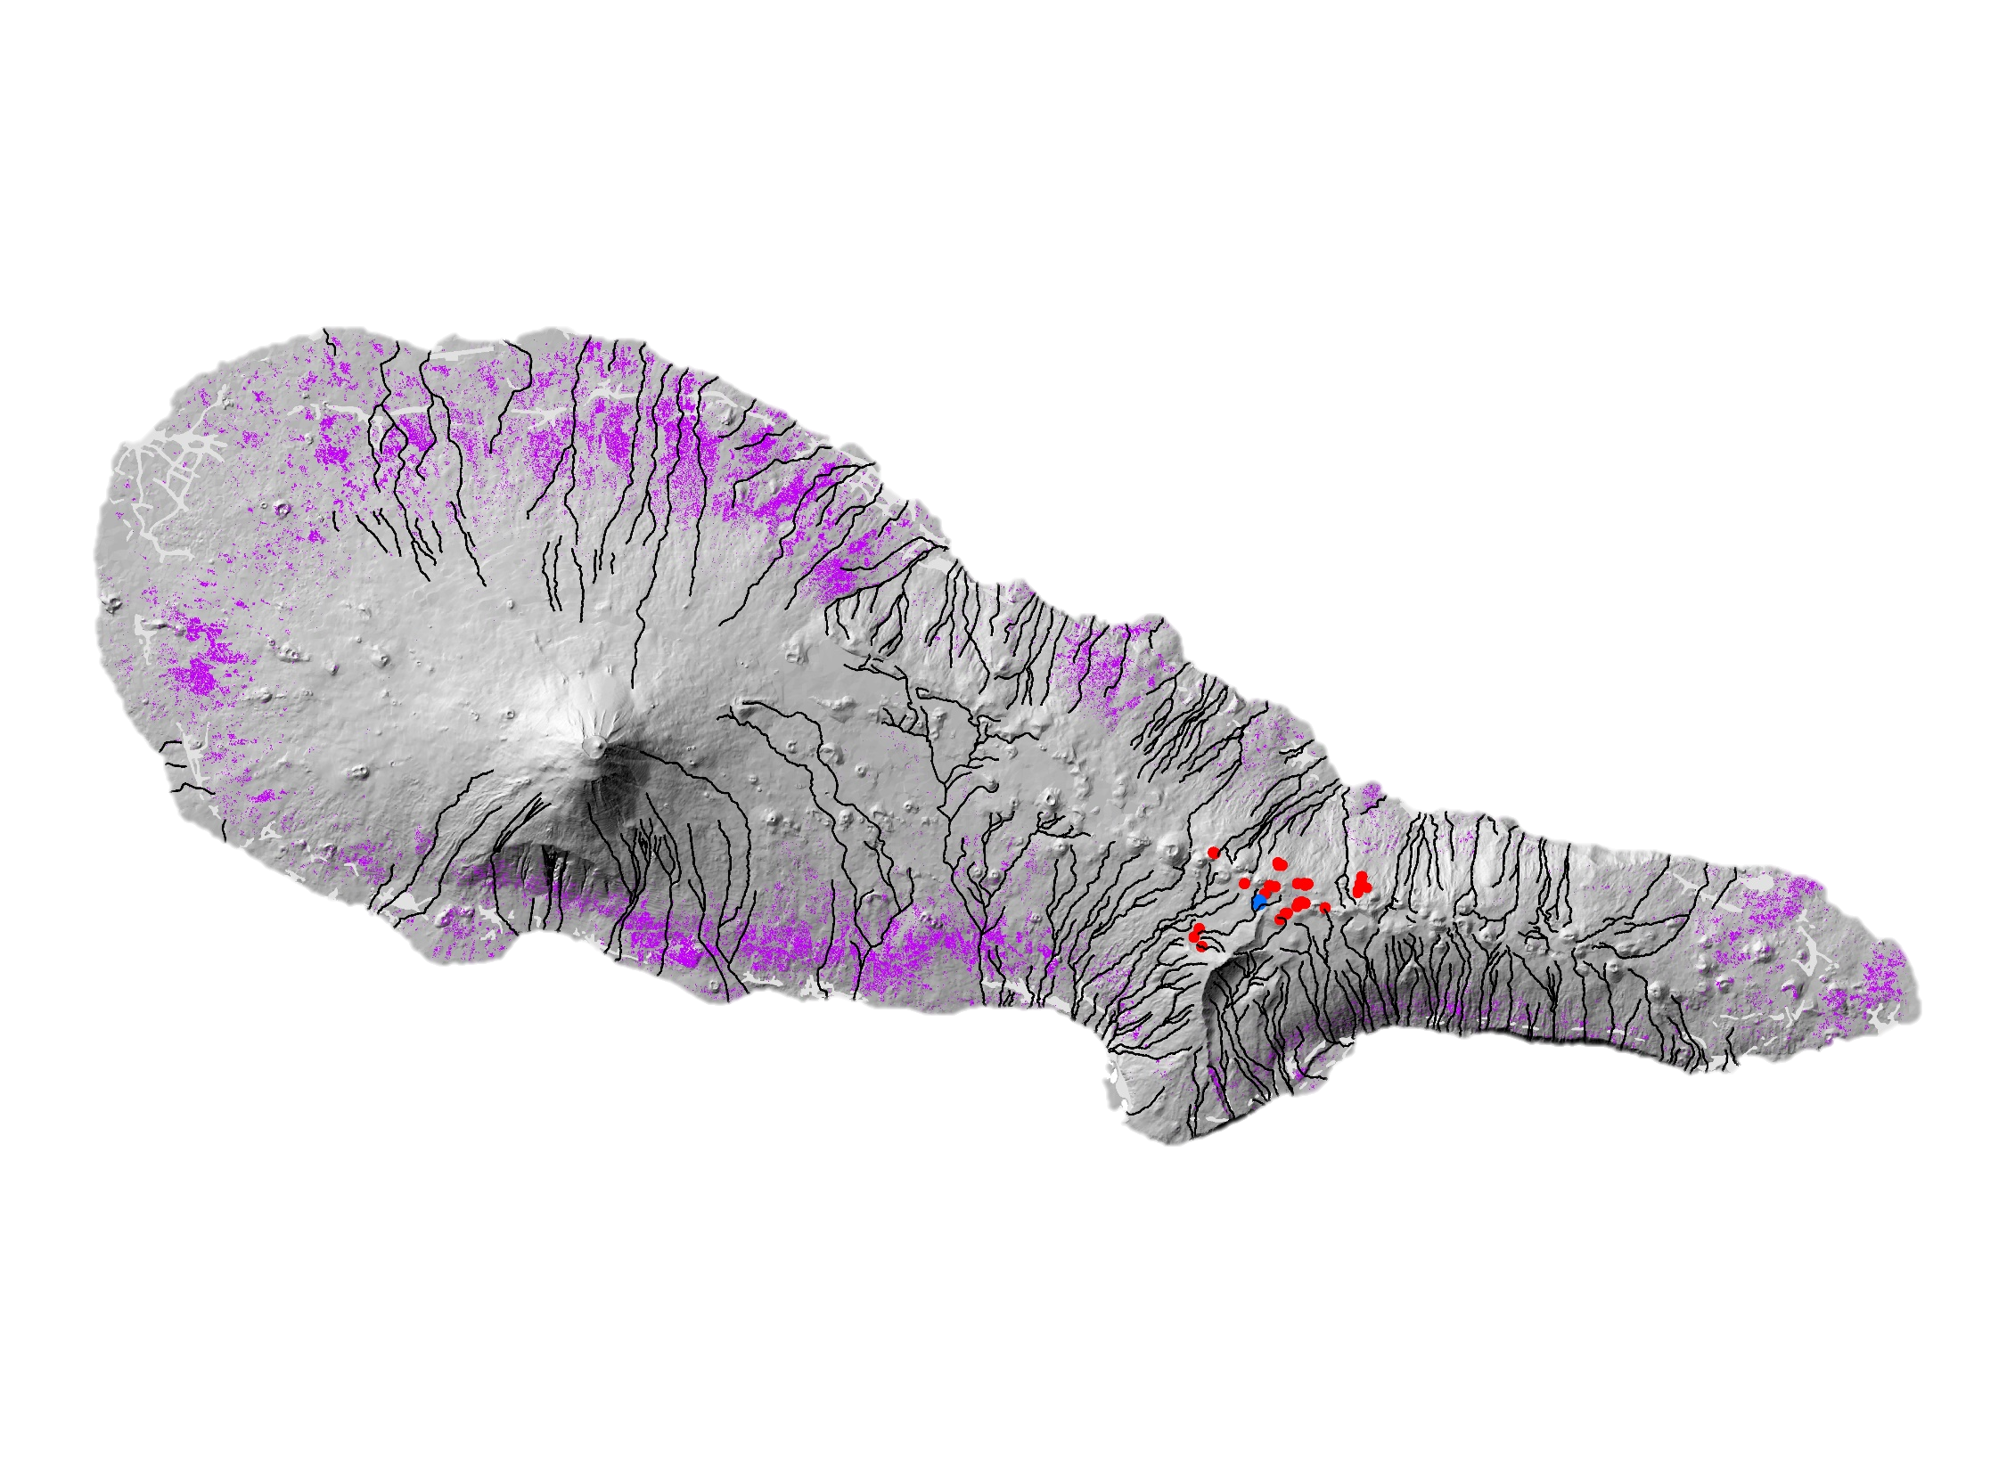

Potential Uses
Support to long-term monitoring of IAS control – LIFE IP AZORES NATURA
  Detection of the distribution area of Invasive Plant species in the interior and coastal areas of the islands on Sentinel-2*:
    Pittosporum undulatum
Group of Applied Plant Ecology
Azores University
Scientific Coordination: Eduardo Dias
GIS Laboratory: Dinis Pereira
* Dias et al. (2019). Estado de Conservação e Relatório de Monitorização das Plantas
e Habitats Terrestres da Diretiva Habitats para o período 2017-2018.

Slide 9
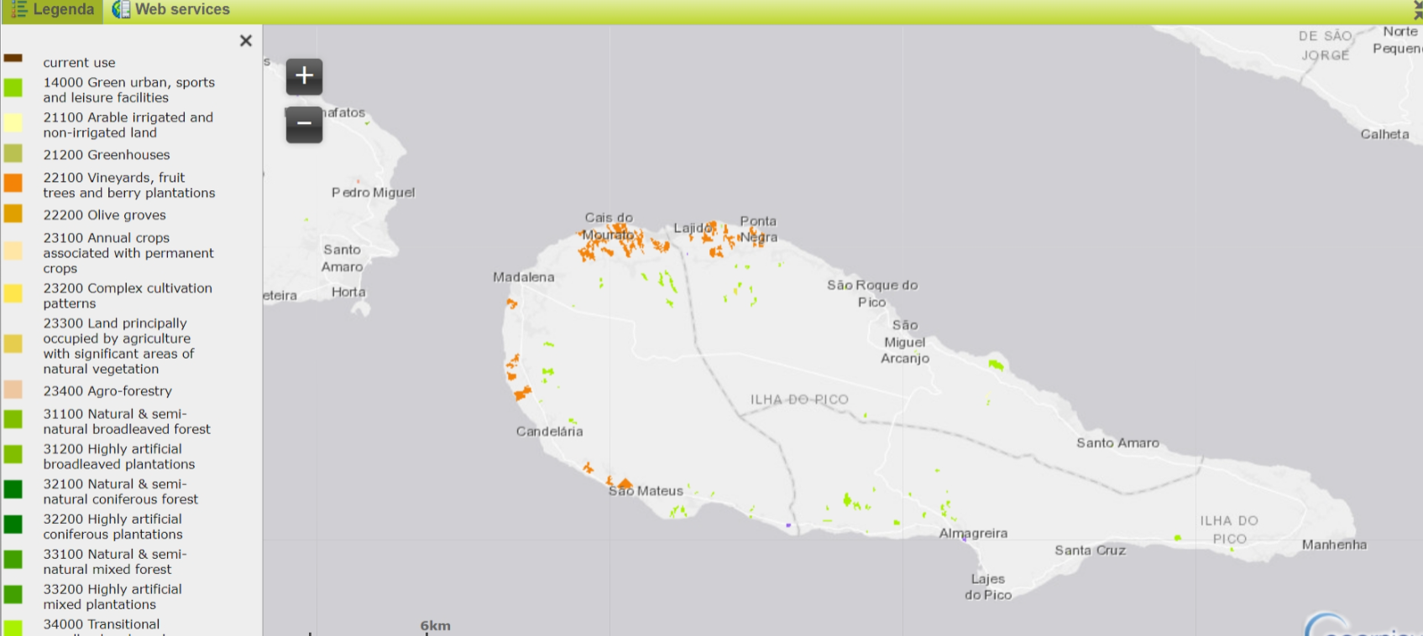
Potential Uses
Support to monitoring of impacts from EU funding policies on land use change towards landscape recovery:
  Pico Vineyards

Slide 10
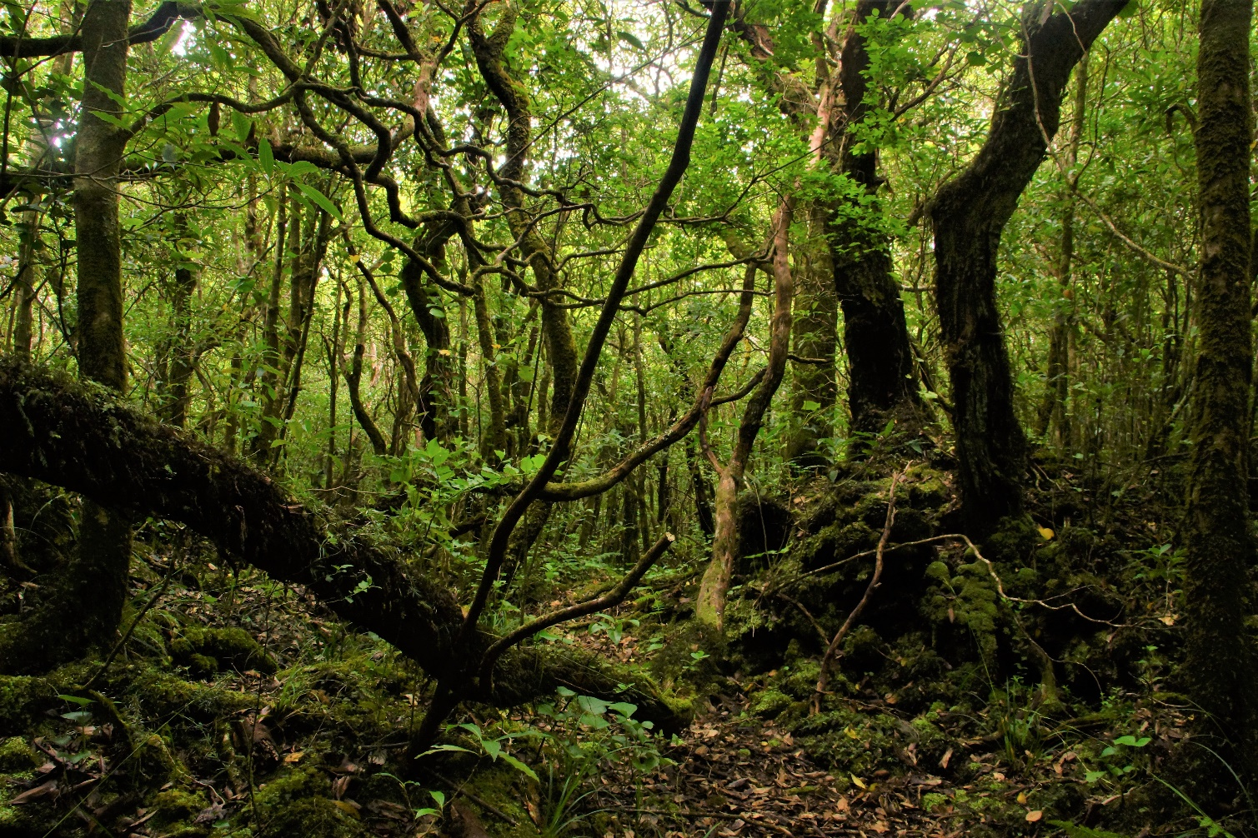
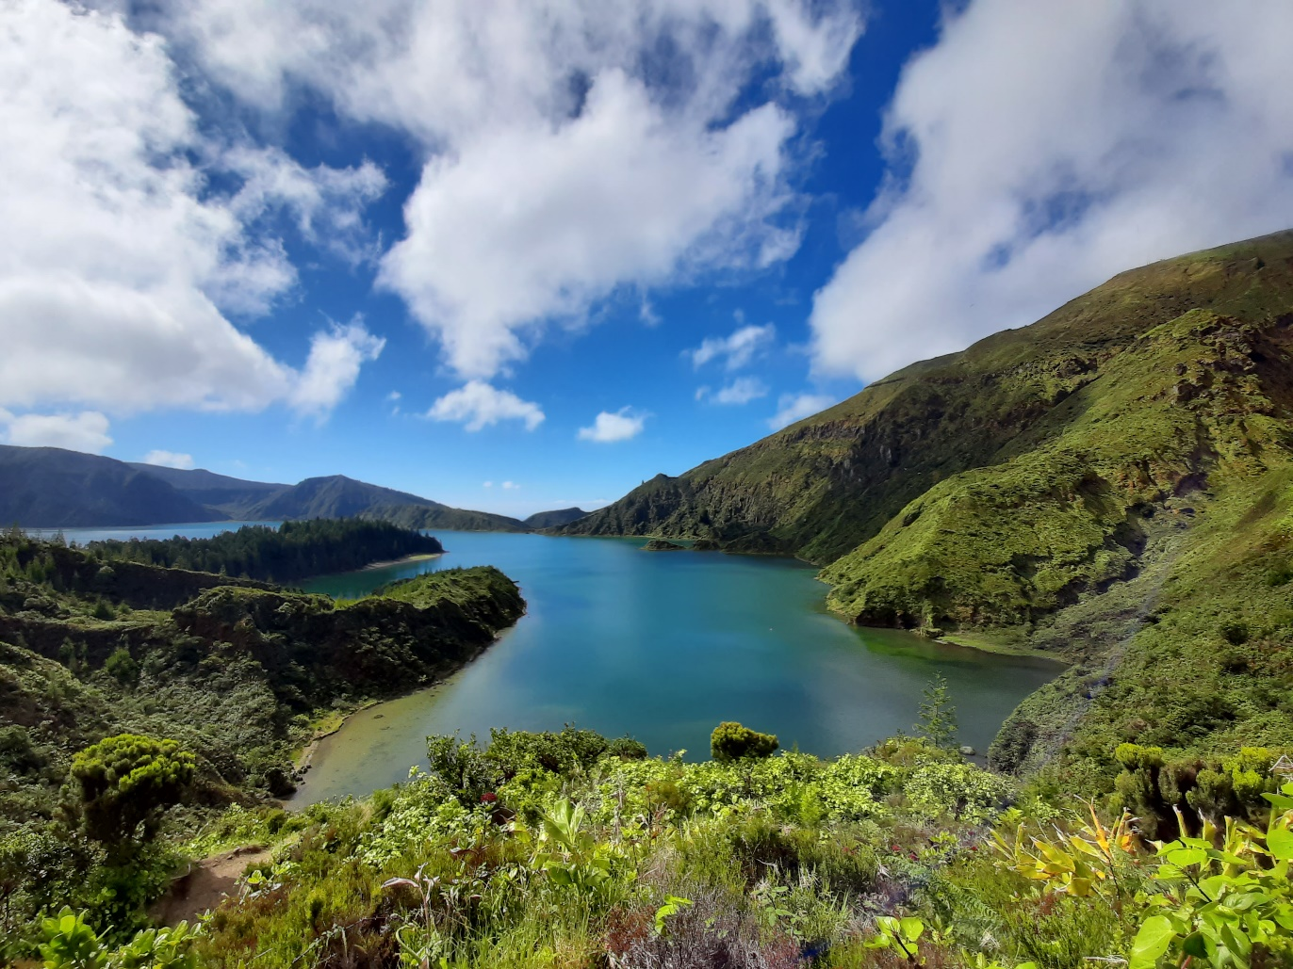
Potential Uses
Support to obligatory LIFE monitoring of ecossystem services:
  Nomenclature of Coastal Zones is designed based on the MAES ecosystem typology, as part of the EU Biodiversity Strategy to 2020
Indicators to consider when assessing ecosystem services in the LIFE IP AZORES NATURA intervention areas:
Regulating services:
  1- Mass stabilization and control of erosion rates
  2- Soil Protection

Slide 11
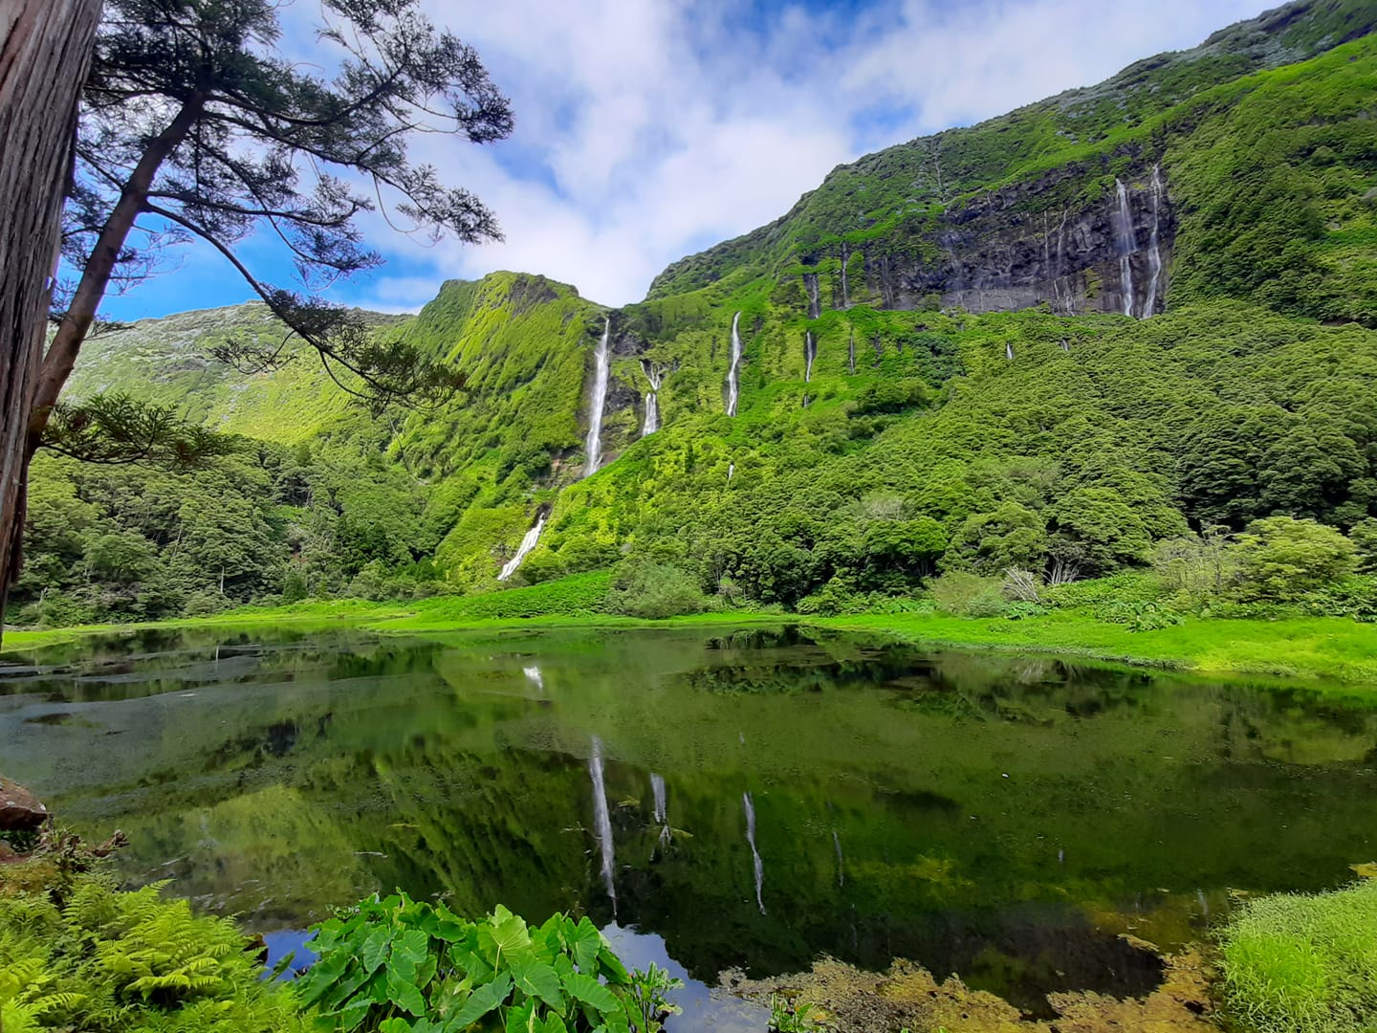
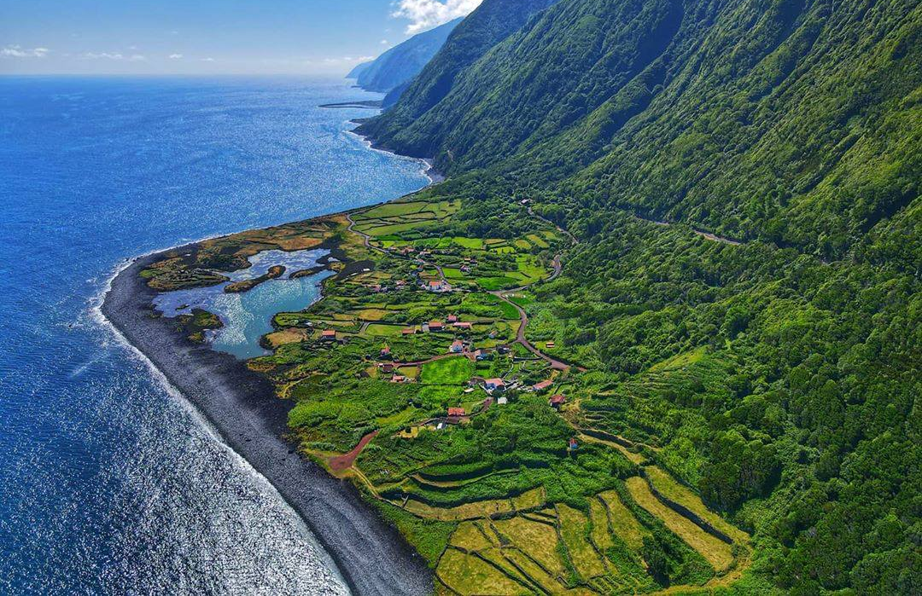
Potential Uses
Support to monitoring of coastal risks (landslide, erosion) – LIFE IP CLIMAZ
  AZMONIRISK - Monitoring of Azores Risk Zones

Slide 12

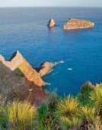
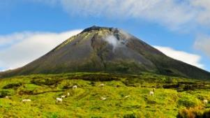
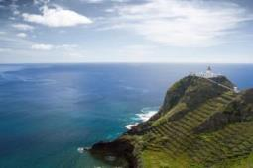
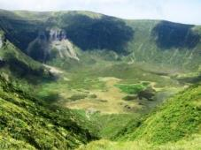
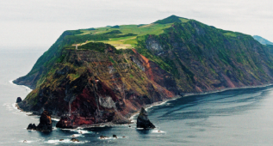
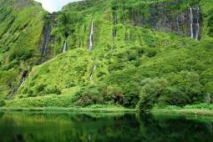
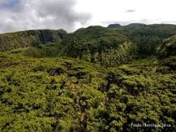
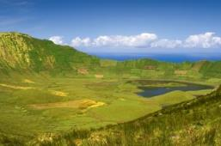
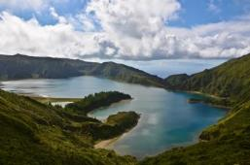

Potential uses of Coastal Zone cartography to support ongoing LIFE projects in an island context: the case of the Azores
Thank you!

